Slide 1



SKIP THE PHONES CAMPAIGN!
2023 DCH Strategic Initiative: Getting Our Retirees
To The SHBP Enrollment Portal for the Retiree Option Change Period
Presented to: SHBP Retirees
Presented by: Member Services, SHBP Eligibility & Benefits Administration Unit
Date: September 2023
Notes:
Hello everyone, my name is Cheryl Rennie. I am a Lead Project & Program Manager at ADP responsible for supporting SHBP Benefits Administration. I’m here today to present information to SHBP retirees regarding the SHBP Enrollment Portal that will used during this year’s Retiree Option Change Period. The sharing of this information is intended to answer any questions you may have about navigating within the Enrollment Portal and possibly even eliminate the need to contact SHBP Member Services. Let’s get started….

Slide 2

Mission
The mission of the Department of Community Health is to provide access to affordable, quality health care to Georgians through effective planning, purchasing,
and oversight.
We are dedicated to A Healthy Georgia.
Notes:
But first, let’s share the Mission of the GA Department of Community Health. Its mission is, as shown here, to provide access to affordable, quality health care to Georgians through effective planning, purchasing, and oversight.
We are dedicated to A Healthy Georgia.
Now let’s review more details as to why we are here today.

Slide 3
Purpose
The purpose of the Skip the Phones Campaign! is to steer our membership, especially Retirees, to the new SHBP Enrollment Portal for the Retiree Option Change Period (ROCP), which will:
Help Retirees become comfortable with virtually taking control of their benefits; and
Reduce Retirees dependency on the SHBP Member Services call center.
Additionally, due to a shortage of staff across the country, we expect increased call volume and extensive delays during this year’s ROCP. Proactively steering Retirees to the SHBP Enrollment Portal will prevent and/or reduce these delays.
The information provided in this presentation is intended only as a snapshot. If you
have additional questions, please email SHBP Member Services at
SHBPservicecenter@adp.com and you will receive a response within 1 to 2 business days.
Notes:
Due to staffing shortages across the country it’s expected that there will be increased call volume and extensive wait times to speak with SHBP Member Services during this year’s Retiree Option Change period.
The purpose of this presentation is to prepare retirees for the Retiree Option Change Period so that they are comfortable with making benefit elections independently thereby reducing the dependency on SHBP Member Services.
If you have any questions during the Retiree Option Change Period and your time is limited then you might want to consider emailing SHBP Member Services at SHBPservicecenter@adp.com.

Slide 4
Agenda
Important Information for the 2023 Retiree Option Change Period
Registration & Log In
Your Benefits Dashboard
Making Your ROCP Election
Viewing Your Benefits
Manage Information
Need Help?
Notes:
During this presentation we plan to cover with you:
Important information that you need to know about this year’s Retiree Option Change Period
This will be followed by accessing the system - beginning at the user registration process (for those retirees that have not previously accessed the Enrollment portal) and the login process for those that have previously accessed the site
Once the registration and login steps are reviewed we’ll then review all steps involved in the benefits selection process including:
Reviewing the benefits dashboard
Making your Retiree Option Change Period benefit selection
Viewing your current and future benefits
Followed by a review of how to manage your personal information such as your physical address; mailing address; email address as well as Medicare information.
We’ll then conclude the presentation by sharing information regarding how to obtain assistance during the Retiree Option Change Period.
Now let’s get started….

Slide 5

Important Information for the
2023 Retiree Option Change Period
Notes:
First, we’ll review the important information.

Slide 6
Important Information for the
2023 Retiree Option Change Period
This year’s Retiree Option Change Period is a “Passive Enrollment” period, which means the vendors and plan options offered by SHBP will remain the same as last year, so Retirees currently enrolled in coverage are not required to make an election unless they want to make changes.
Retirees currently enrolled in coverage who take no action will simply roll over to the same plan option they are currently enrolled in.
So, if you’re happy with your current plan option and have no changes, you don’t have to take any action for this year’s ROCP.
Skip the Phones!
Notes:
As described here, this year’s Retiree Option Change Period is a “Passive Enrollment” period. This means that not only the vendors but the plan options offered by SHBP will remain the same as last year, so Retirees currently enrolled in coverage are not required to make an election unless they want to make changes.
Retirees currently enrolled in coverage who take no action will simply roll over to the same plan option they are currently enrolled in.
So, if you’re happy with your current plan option and have no changes, you will not need to take any action within the Benefits Enrollment Portal nor do you need to call Member Services to confirm your benefit selection for this year’s Retiree Option Change Period.

Slide 7
Registration & Log In
Notes:
Now let’s review the registration and login process for the Enrollment Portal….

Slide 8
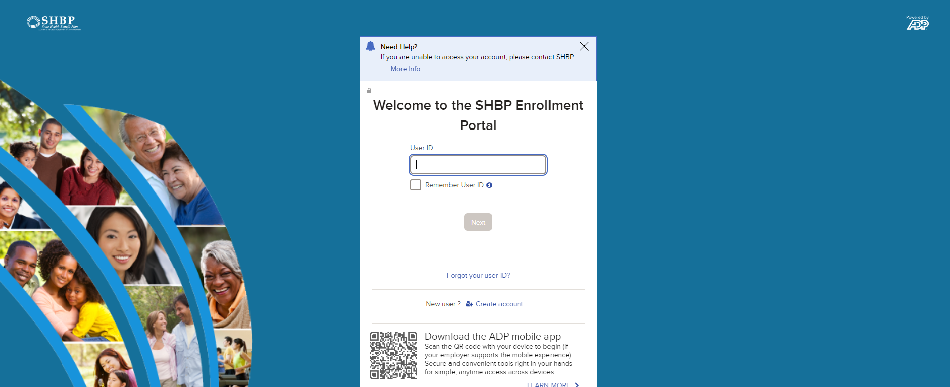
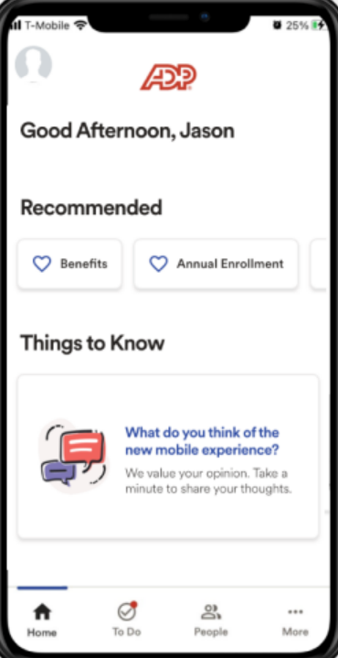
Registration & Log In
Retirees may access the SHBP Enrollment Portal at https://myshbpga.adp.com
24 hours a day, 7 days a week.
The mobile application is also available.
You must have a User ID and Password to access the Portal.
Notes:
Members may access the SHBP Enrollment Portal at https://myshbpga.adp.com 24 hours a day, 7 days a week.
You can also scan the QR Code shown here on the login page to download the mobile application and complete your enrollment.
You must have a User ID and Password to access the Portal.

Slide 9
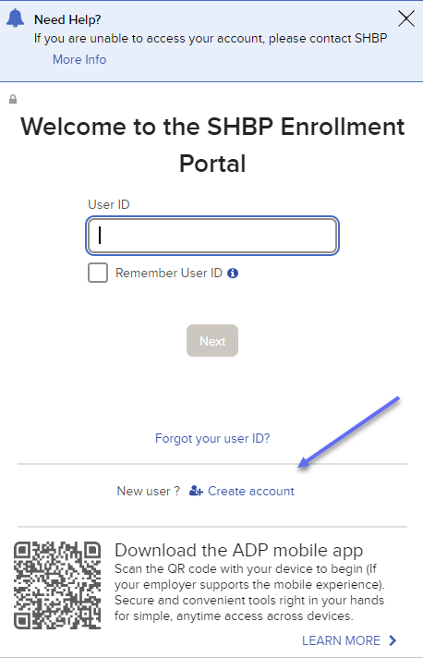
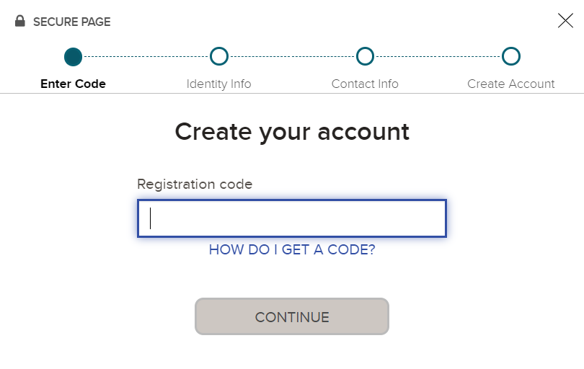
Registration & Log In
Create your Account. If you do not have a User ID and Password, select Create Account.
The registration code is SHBP-GA.
Notes:
Select the create your account option on the screen if you never accessed the Enrollment Portal. You will then be prompted to enter the registration code. This code to be entered is SHBP-GA.
Please note it’s recommended that you attempt to access your account or register your account in advance of the Retiree Option Change Period window opening on October 16th to ensure that you can make your plan selections once the window does open.
You can then expect to see…

Slide 10
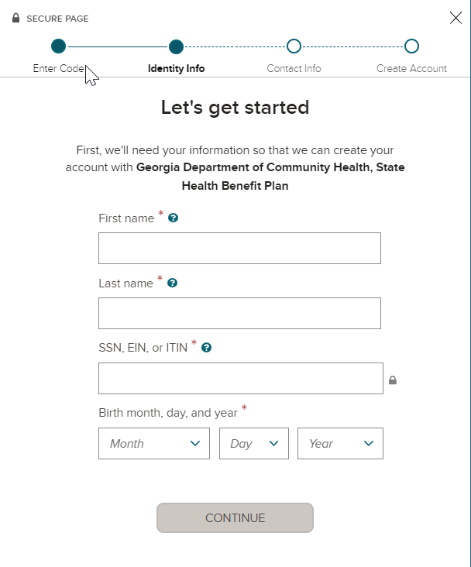
Registration & Log In
Let’s get Started. Enter your:
First and Last Name,
SSN, EIN or TIN, and
Birth month, day and year.
If you click the question marks you’ll receive helpful information to assist you with completing the fields.
Then enter your frequently used email address (e.g., john.doe@gmail.com) and mobile number to create your account and receive account notifications.
Notes:
A screen where you would enter your first name; last name; SSN, EIN or TIN; and your birth month, day, and year. If you have questions about what should be entered into each field then hover over the ? Icon.
Once you’ve entered this information then you’ll be prompted to provide your frequently used email address as well as your mobile number so that you are able to receive account activity information.
Your account registration is now complete.

Slide 11
Registration & Log In
Record Not Found.
If after you enter the information on this screen a message is returned indicating that there is no record of your information then:
Double-check the information entered to confirm its accuracy
Please review our website at https://shbp.Georgia.gov/enrollment-portal.
Notes:
If after you enter the information on this screen a message is returned indicating that there is no record of your information then:
Double-check the information entered to confirm its accuracy
If all information is accurate then go to the website address here for guidance on how to proceed.

Slide 12
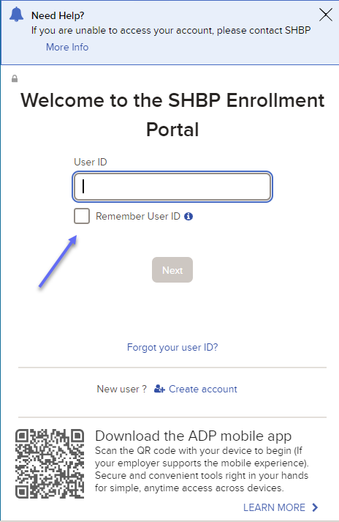
Registration & Log In
If you’ve already registered, to log in, enter your User Id and click Next. If you check the box next to Remember My User ID, it will automatically populate your User ID the next time you visit the Portal.
Note: To protect your personal information, you should not select Remember My User ID when using a public computer or a computer that others have access to.
Notes:
Once you’ve successfully setup your account, on the login page enter your User ID. You may choose to hover over and then click on the box appearing to the left of the Remember User ID text; however, to ensure your information is protected, DO NOT select this box if you’re using a public computer or a computer that others may be able to access.
If you do not know your User ID, hover over and then click on the Forgot Your User ID link that appears below the Next button.
Once you’re User ID has been entered, hover over and then click on the Next button

Slide 13
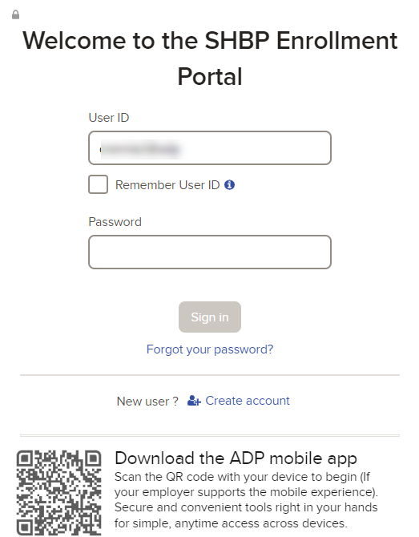
Registration & Log In
Then enter your Password and click Sign In. For Security Purposes, your Password expires every 45 days.
If you do not know your current User ID or Password, click the Forgot Your User ID? or Forgot Your Password? links.
Having Trouble Logging In? If you are a new user, please review our website at https://shbp.Georgia.gov/enrollment-portal.
Notes:
You’ll then have a box shown for you to enter your password (and be aware that it expires every 45 days). If you do not know your current password then select the Forgot Your Password link found below the Sign In button.
If you’re having trouble logging in then review the information found at the SHBP website address shown here.

Slide 14
Your Benefits Dashboard
Notes:
Once you’ve been able to successfully login, you’ll want to review the Benefits Dashboard

Slide 15
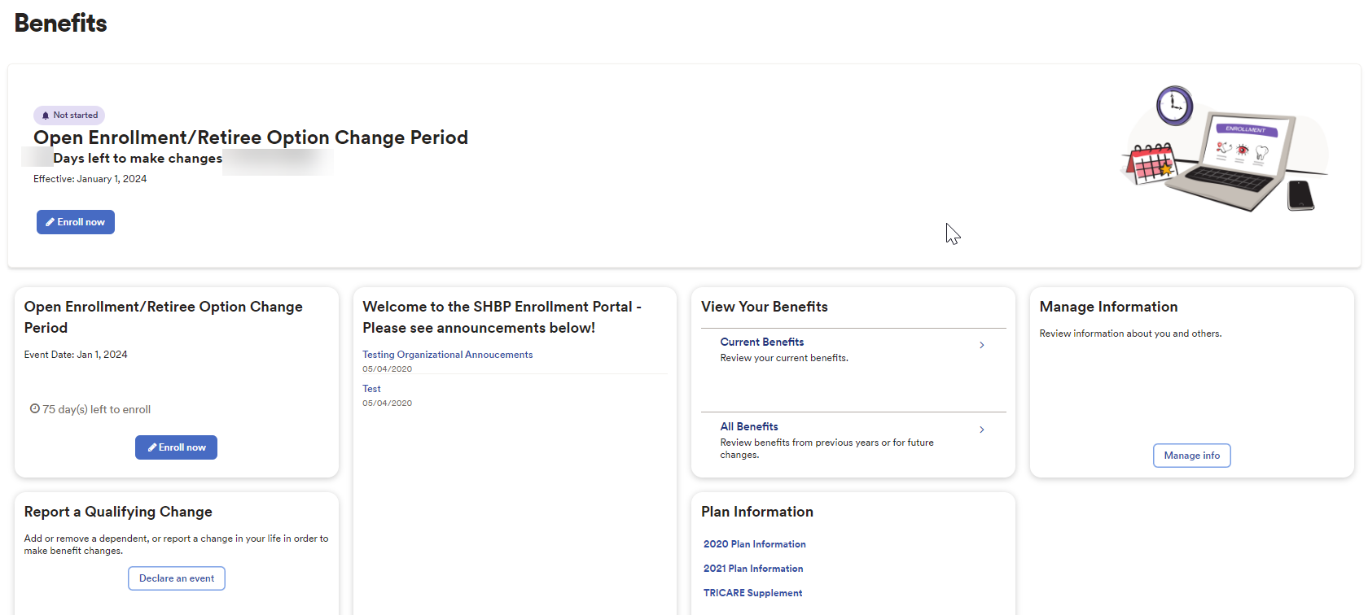
Your Benefits Dashboard
The Your Benefits Dashboard features different Tiles: View Your Benefits, Report a Qualifying Change, Manage Information, and Company Links.
Notes:
As shown here, there will be several tiles available to you on the Benefits Dashboard; however, for our discussion today we’ll be spending the majority of our time focusing on the Retiree Option Change Period…

Slide 16
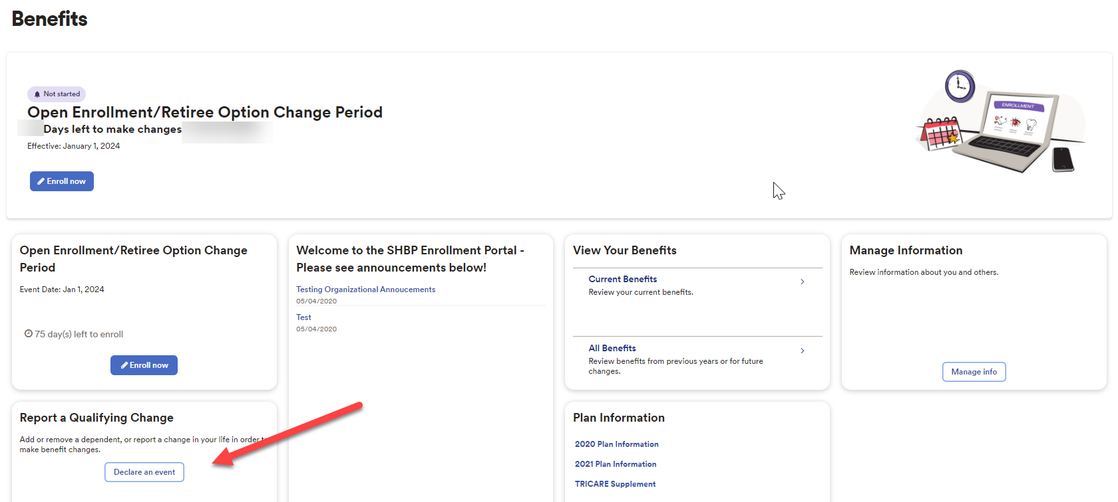
Your Benefits Dashboard
Additionally, there are Life Events in the Portal which allow Retirees to change their Plan Option, e.g., becoming Medicare Eligible due to turning Age 65 is an automated event. Based on your age in the SHBP Enrollment Portal, prior to you turning Age 65, a Tile will appear allowing you to make changes to your coverage. For this presentation, we are specifically focusing on making your elections in the Portal during OE/ROCP.
Notes:
You can make other changes using the tiles found on the Benefits Dashboard. An example of such a change is when a retiree turns Age 65 – which is an event that is automatically triggered and that will appear in a tile on the Dashboard to allow you to make changes to your coverage. As stated though, today’s presentation is primarily focused on making your plan selection in the Enrollment Portal during the Retiree Option Change Period.

Slide 17
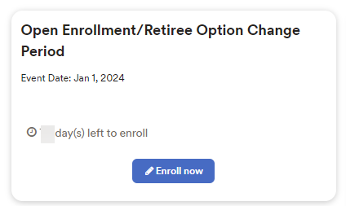
Your Benefits Dashboard
At 12:00am, October 16th, 2023, the first day of the Open Enrollment/Retire Option Change Period (OE/ROCP), when you log into the SHBP Enrollment Portal, you will see an “Open Enrollment/Retiree Option Change Period” tile allowing you to make your annual election. This Tile will display until 11:59pm, November 3rd, 2023, the last day of OE/Open Enrollment.
Notes:
You can expect to see the Open Enrollment/Retiree Option Change Period tile as shown here once the change period opens. This year the change period will open At 12:00am, October 16th, 2023, allowing you to make your annual plan selection. This Tile will display until 11:59pm, November 3rd, 2023, the last day of the Retiree Option Change Period.
Should you want to make a change to your benefits for this year’s Retiree Option Change Period, go to the Open Enrollment/Retiree Option Change Period tile; hover over and then click on the Enroll Now button.

Slide 18
Making Your ROCP Election
Notes:
Now let’s review how you can make your Retiree Option Change Period election…

Slide 19
Making Your ROCP Election
Important Information for Retirees
During ROCP, Retirees may:
  Enroll in any plan option which they are eligible for,
  Terminate dependent(s) coverage
  However, Retirees cannot increase their tier, meaning Retirees cannot add dependents during ROCP.
If you’re happy with your current plan option and have no changes, please do not take any action for this year’s ROCP. Everything will carry over to the 2024 Plan Year, unless you:
  Fail to make your premium payments and your coverage is terminated; and/or
  Fail to maintain valid Medicare information if you are currently enrolled in a SHBP Medicare Advantage Plan Option and the Centers for Medicare and Medicaid Services (CMS) terminates your coverage.
Notes:
But first, let’s review some important information about the Retiree Option Change Period….
During ROCP, Retirees may:
Enroll in any plan option which they are eligible for,
Decrease their tier by terminating their dependent(s) coverage (e.g., changing from “You + Family” to “You + Spouse,” “You + Child,” or “You Only”),
However, Retirees cannot increase their tier, meaning Retirees cannot add dependents during ROCP.
If you’re happy with your current plan option and have no changes, please do not take any action for this year’s ROCP. Everything will carry over to the 2024 Plan Year, unless you:
Fail to make your premium payments and your coverage is terminated; and/or
Fail to maintain valid Medicare information if you are currently enrolled in a SHBP Medicare Advantage Plan Option and the Centers for Medicare and Medicaid Services (CMS) terminates your coverage.
Now let’s take a look at how you would make your plan selection should you want to make a change to your benefits.

Slide 20
Making Your ROCP Election
Things to Note:
  If you are a former Retiree who is not currently enrolled in SHBP Retiree Coverage or if your coverage has been terminated due to non-payment for any reason, you will not be able to enroll in Coverage unless you return to work in a benefits eligible position with a SHBP Employing Entity.
  If you elect coverage, but your coverage is later terminated for any reason, your election will not take effect or will be removed.
  If you believe an error has occurred, you may contact SHBP Member Services at 800-610-1863 for additional information.
Notes:
Some important points to remember are that:
If you are a former Retiree who is not currently enrolled in SHBP Retiree Coverage or if your coverage has been terminated due to non-payment for any reason, you will not be able to enroll in Coverage unless you return to work in a benefits eligible position with an SHBP Employing Entity.
If you elect coverage, but your coverage is later terminated for any reason, your election will not take effect or will be removed.
If you believe an error has occurred, you may contact SHBP Member Services at 800-610-1863 for additional information.

Slide 21
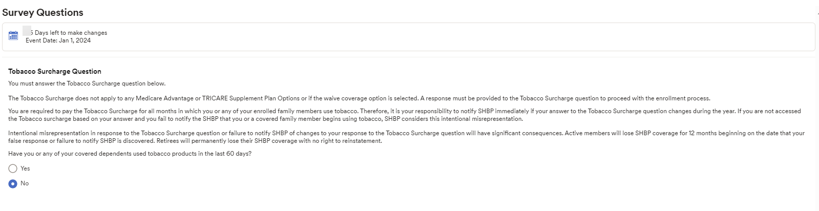
Making Your ROCP Election
After selecting Enroll Now you will navigate to the Tobacco Surcharge survey – if you have not previously declared your tobacco usage. The Surcharge is $80 per member per month, meaning it is a monthly flat fee that is charged no matter how many individuals in the family use Tobacco.
Notes:
Prior to making your plan selection, you’ll want to review the information carefully for the Tobacco Surcharge survey. Please note that if you previously declared your tobacco usage, this page will not be automatically presented to you.
Once you’ve reviewed the information you can respond to the question by hovering over and then clicking the Yes or No radio button to reflect your response to it. Something that you need to know about the tobacco Surcharge is that it is $80 per member per month –regardless of how many individuals in the family use Tobacco.

Slide 22
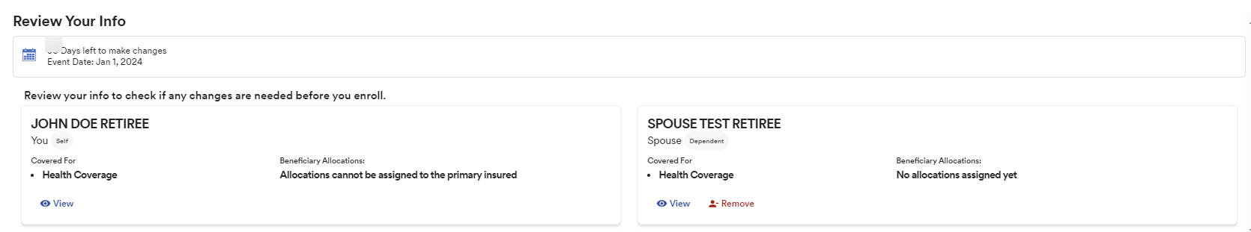
Making Your ROCP Election
After you complete the Tobacco Surcharge survey or, if you previously declared your tobacco usage, you will navigate to Review Your Info as shown in screenshot below.
Notes:
After you provide your response to the Tobacco usage question, you’ll be automatically routed to the Review Your Info screen as shown here.
On this page you’ll see yourself as well as your dependent (or dependents) attached to your record as well as an indication as to who is enrolled in coverage. Please note that the information on this page is limited to removing a dependent (or dependents) from your record (and coverage).
If you don’t have any dependent updates to make, then select the Enroll in Benefits link shown on the left side of the page.

Slide 23
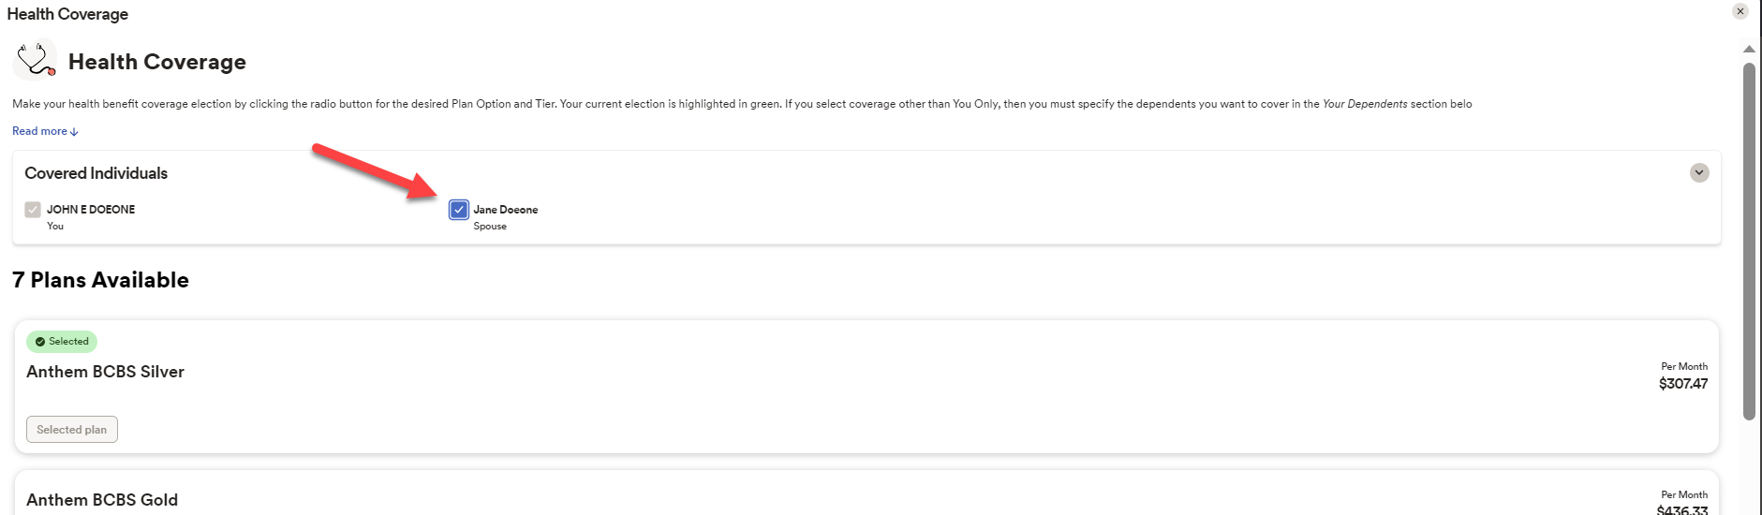
Making Your ROCP Election
Select Who Is Covered. You also must ensure you indicate who should be covered under the Covered Individuals section. If applicable, select any eligible dependents you would like to continue covering in Plan Year 2024.
Note: Any eligible dependents you fail to select will not be covered in Plan Year 2024, which means their coverage is effective through December 31, 2023 and terminates effective January 1, 2024.
Notes:
As you are viewing, and considering your plan choice for 2024, you’ll want to also view your dependents that are (or are not) covered. For those dependents that you want to cover for 2024, you’ll want to confirm that they have a check mark in the box to the left of their name. Any eligible dependents you do not select for coverage will not be covered for 2024 so their last day of coverage will be December 31, 2023.

Slide 24
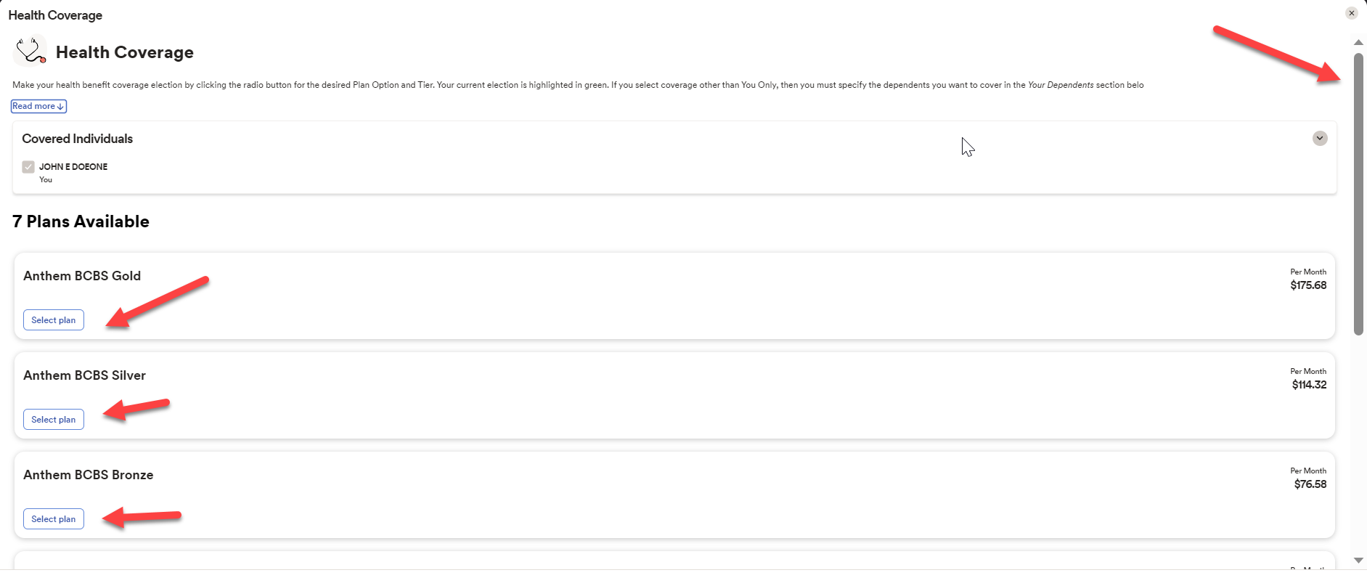
Making Your ROCP Election
Next, to select your plan hover over and click on the ‘Select plan’ button. Also, be sure to use your vertical scroll bar to see all plans available to you.
Notes:
You’ll then select your plan option within the Health Coverage section.
There will be multiple plans displayed for you and you’ll probably need to use your vertical scroll bar on the right side of the screen to see all available plans.
Once you have determined which plan is right for you for 2024, then hover over and click on the Select Plan button appearing below the plan name.

Slide 25
Making Your ROCP Election
Note: To learn additional information regarding our plan options, you may also:
View the Retiree Decision Guide which was mailed to all Retirees in September 2023 and available on our website here https://shbp.georgia.gov/enrollment/open-enrollment and/or,
Contact the medical vendor (i.e., Anthem, Kaiser, or UnitedHealthcare) offering the plan option directly via the contact information in the Retiree Decision Guide and available on our website here: https://shbp.georgia.gov/plan-options-programs.
Notes:
To learn more information about the plan choices available to you then check out the 2024 Retiree Decision Guide mailed to all retirees in September, 2023. The link to where you can find a copy of the guide is shown here. Another option is for you to contact the medical vendor using the contact information provided within the Decision Guide or you can go to the SHBP website link shown here for this contact information.

Slide 26
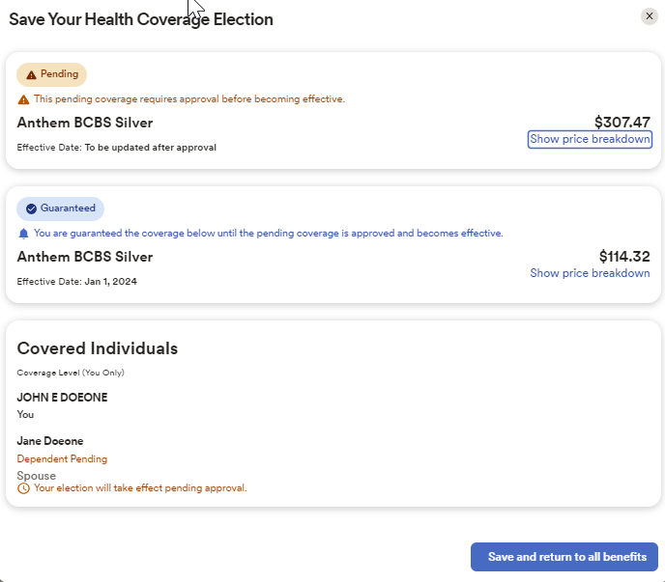
Making Your ROCP Election
After you elect Coverage or Waive Coverage, you will navigate to the Save Your Election page. This page provides an overview of the election being saved including plan option, cost and covered dependents. If you need to make changes, click Save and Return to all Benefits.
Notes:
Once you have all information you need to make a plan selection that’s right for you, you’ll navigate to the Save Your Health Coverage Election page. This page will provide you with an overview of the plan selection as well as the covered dependents and costs for it. If you’re satisfied with this choice or would like to make any changes, at the bottom of the screen hover over and click on the Save and Return to All Benefits box. This will then bring you to the Review Elections page…

Slide 27
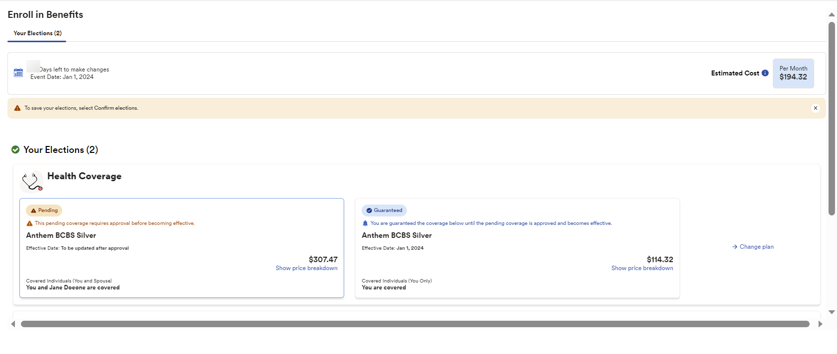
Making Your ROCP Election
Notes:
Shown here is what you can expect to see on the Enroll in Benefits page….take note of any Pending and/or Guaranteed coverage appearing. In the example shown here, it reflects that coverage for a new dependent is pending.

Slide 28

Making Your ROCP Election
If you are satisfied with your coverage election(s) as well as any covered dependent(s) page as shown in the next screenshot. Here you can review your elections, including any pending elections as applicable, and estimated costs. Select:
  “Finish Later,”
  “Back” to make changes, or
  “Confirm Elections” to complete your enrollment for January 1, 2024.
Notes:
The 3 buttons appearing at the bottom of the screen will provide you with these options:
Finish later - allows you to save what you’ve selected thus far and then return to it later.
Back – that allows you to make changes to your plan selection as well as covered dependents.
Confirm Elections – will save the plan option and covered dependents you’ve selected for 2024.
Please note that if you choose the Finish Later option you MUST return to the Enrollment Portal prior to the end of the Enrollment window on November 3rd 11:59pm ET to select the Confirm Elections button and agree to the Terms & Conditions of enrollment – which you’ll hear about in just a moment
If you do not return to the Enrollment Portal by the end of the Enrollment window and do not select the Confirm Elections button as well as agree to the Terms & Conditions, for 2024 you will remain in the same plan with the same covered dependents that you had for the 2023 plan year – unless that plan is no longer available to you.

Slide 29
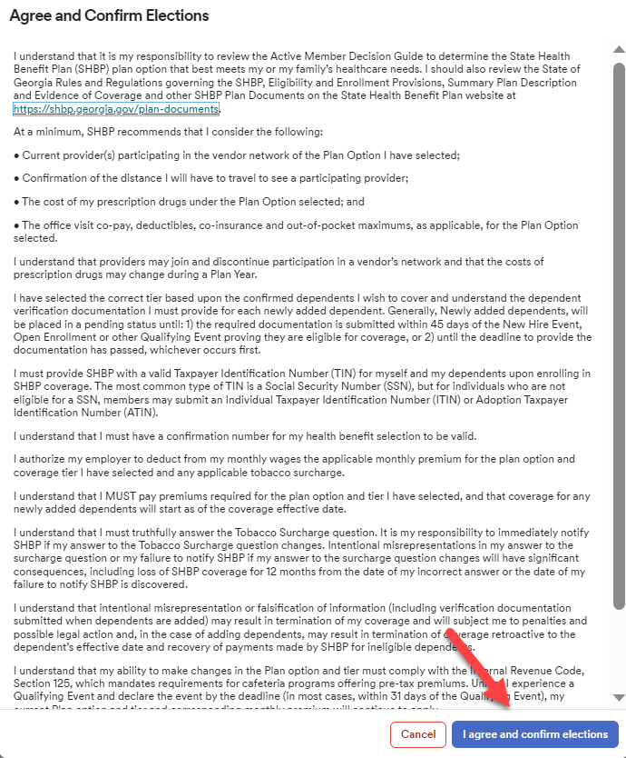
Making Your ROCP Election
The final step to confirm your elections is the I AGREE AND CONFIRM ELECTIONS page. You must select I AGREE AND CONFIRM ELECTIONS at the bottom of the page to complete your election.
Failure to select I AGREE AND CONFIRM ELECTIONS will result in you remaining in the same Coverage status that you were enrolled in during the 2023 Plan Year.
Notes:
Once you’re satisfied with your plan selection and covered dependents, the final step in the enrollment process is to hover over and then click on the I Agree and Confirm Elections button. This is the final step in the enrollment process. Failure to click on the I Agree and Confirm Elections button will result in you remaining for 2024 in the same plan with the same covered dependents that you had for the 2023 plan year.

Slide 30
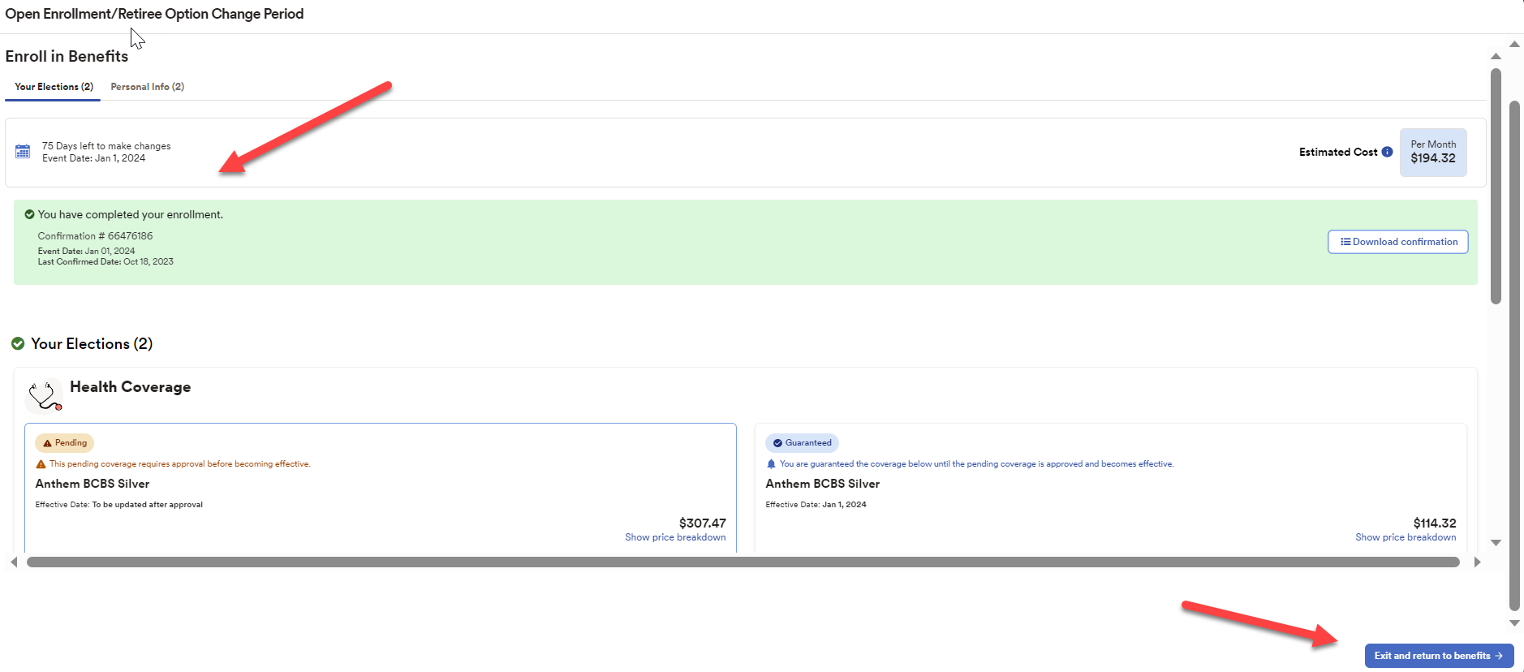
Your Completed ROCP Election
This is what you can expect to see once you’ve completed your election.
Here you can download your confirmation statement and/or exit the open enrollment election process.
Notes:
Once you’ve confirmed your election and covered. dependents, you’ll have this screen displayed for you. If you’d like to download your benefit elections for the 2024 plan year, hover over and then click on the download confirmation button.
To exit, select the Exit and return to benefits button appearing at the bottom of the page.
Now let’s review the additional tiles available to you within the Enrollment Portal.

Slide 31
Viewing Your Benefits
Notes:
This next portion of our training will be a review of the Viewing Your Benefits tile.

Slide 32
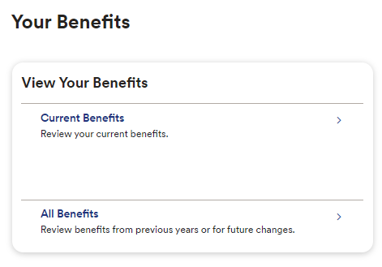
Viewing Your Benefits
In addition to making your Retiree Option Change Period elections, the View Your Benefits Tile under the Your Benefits Dashboard allows you to view your current and prior year’s benefits.
Current Benefits shows your current coverage elections for 2023.
All Benefits shows your prior elections and current election changes made in 2023, as applicable.
Notes:
Within the Your Benefits tile you’ll be able to view the benefits that you have currently have in effect for 2023. You’ll do this by clicking the greater than symbol (also referred to as the right-angle bracket or right arrow) within the Current Benefits tile.
The All Benefits option will provide you with information about your benefits that have been in effect in the past, benefits that are currently active, as well as the benefits that will be effective in the future – which includes your Open Enrollment selection for 2024.
To see the detail found within each of these options, hover over the Current Benefits or All Benefits portion of the tile and then select the greater than symbol in the far right corner of the tile.

Slide 33
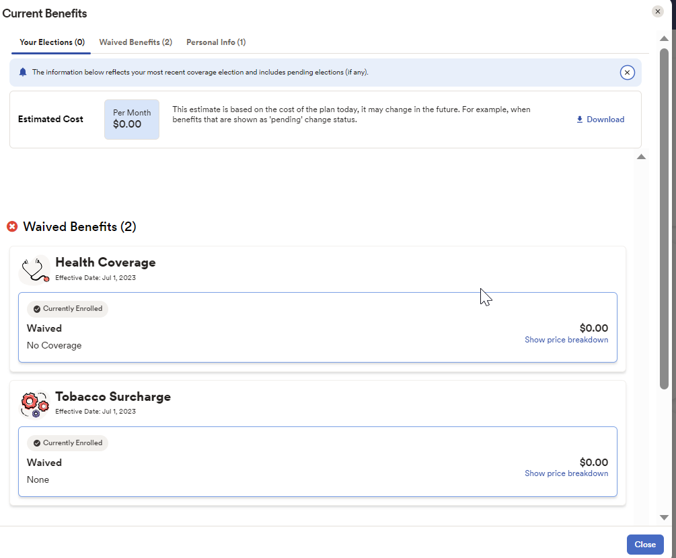
Viewing Your Benefits
Below is a screenshot showing a Retiree’s Current Benefits.
To navigate back to the View Your Benefits Tile, click Close in the
lower right corner.
Notes:
Here is a sample of what you can expect to see for current benefits. To return to the Your Benefits tile, hover over and then click on the Back button appearing in the upper left corner of the page.
Once you’re back on the Your Benefits Tile, if you select the All Benefits option….

Slide 34
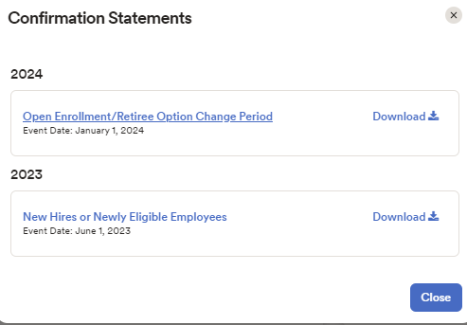
Viewing Your Benefits
Now that we’ve viewed Current Benefits, select All Benefits to view your prior Events and corresponding elections. For example, this retiree’s screenshot includes an Open Enrollment/Retiree Option Change Period Event.
To view their election, the member clicks the download icon on the right of the Open Enrollment Event.
Notes:
You can expect to see a screen that looks like this with a description for each of the events such as Open Enrollment/Retiree Option Change Period. This would be a great place to navigate to verify your coverage that will be in effect for 2024.
To view the detail for the Open Enrollment/Retiree Option Change Period event, hover over and then click on the download icon appearing on the far right on the Open Enrollment/Retiree Option Change Period event tile. Doing this will download a confirmation statement of your benefit selections for the 2024 plan year. Once the download is complete you can expect to see…

Slide 35
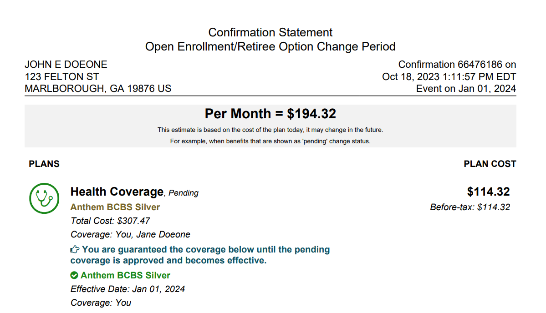
Viewing Your Benefits
The downloaded document is a Confirmation Statement. To navigate back to the Your Benefits Tile, just close the window.
Notes:
A screen that looks similar to this.
For the 2024 plan year specifically, if you’re satisfied with what you see as your benefits and covered dependents, then there’s no need to make an update to your plan selections or call Member Services.
Please note that if there is a valid email address on file, you can expect to receive an email confirming your benefit selection.
To return to the Your Benefits tile, just close the window.

Slide 36
Manage Information
Notes:
Now let’s take a moment to share with you some important information about each retiree’s responsibility to maintain information within the Enrolment Portal….

Slide 37
Manage Information
It is critical for Retirees to ensure SHBP has their updated contact information Upon Retirement and After Retirement.
Upon Retirement: Retirees must update their phone number, home address and email
address in the SHBP Enrollment Portal.
  You should change your work email address to a personal or other email address so you can receive SHBP email notifications.
  You should also update your phone number and home address (i.e., physical address) so you can receive important notifications (e.g., annual Retiree Option Change Period materials such as the SHBP Retiree Decision Guide).
Failure to update your contact information may cause you to miss lapse letters, invoices,
Retiree Decision Guides, Pre-65 Medicare Reminder Letters, and much more.
Notes:
It’s critical that Retirees ensure that SHBP has accurate contact information both pre- and post-retirement.
Specific to when you retire, be sure to update your phone number; home address; and email address within the Enrollment Portal.
If you have your work email address listed in the enrollment portal, it must be updated to a personal or other email address so that you can continue to receive SHBP email notifications.
In addition, you should review, and if needed, update your phone number and physical, home address so that you can receive important notifications such as your Retiree Option Change Period materials – including the Decision Guide – in addition to important reminder letters; invoices; and so much more.

Slide 38
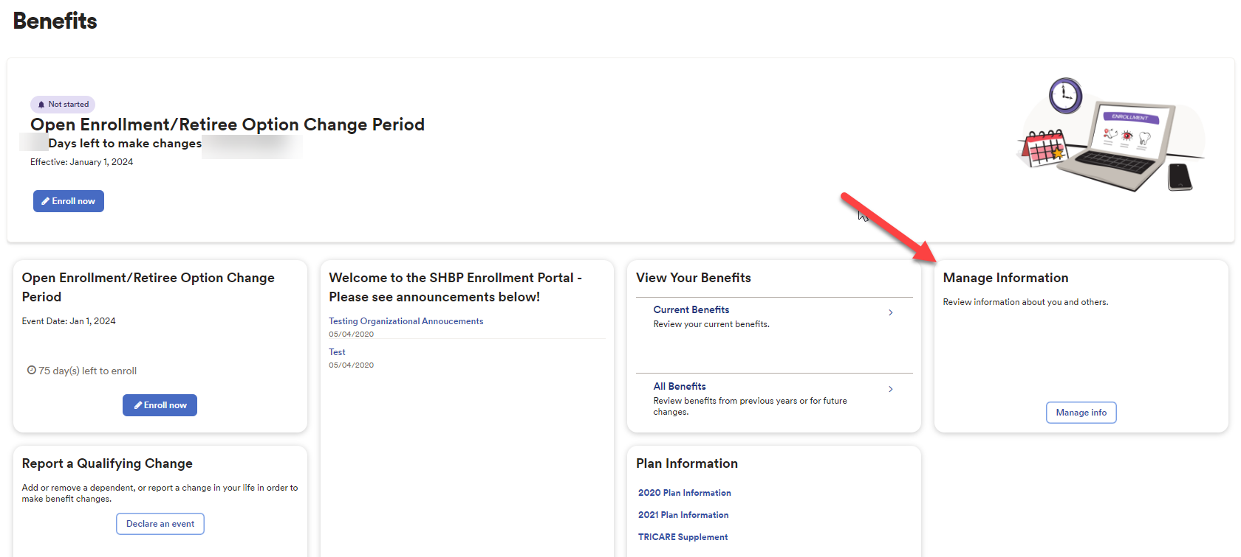
Manage Information
After Retirement: Retirees must continue to update their phone number, home address
and email address in the SHBP Enrollment Portal to ensure we remain in contact with you throughout your retirement. The Manage Information Tile allows you to view and update your personal information and provide Medicare Part B information to SHBP 24 hours a day/7 days a week.
Notes:
Post-retirement, be sure to update your phone number; home address; and email address any time that any or all of these change to ensure that SHBP is able to remain in contact with you.
To update this information, select the Manage Info button found within the Manage Information tile to get started.

Slide 39
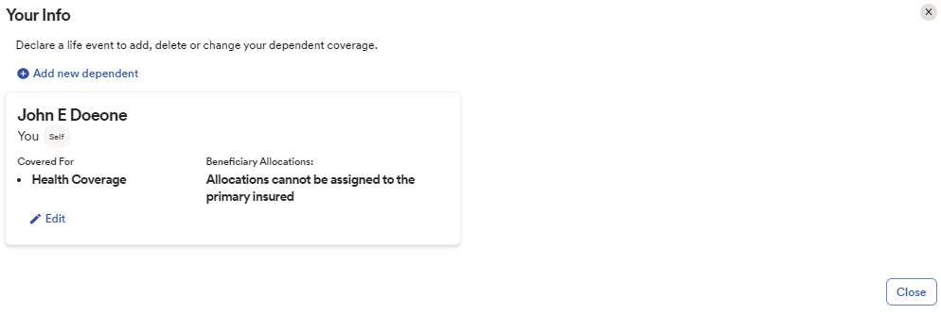
Manage Information
Once you’ve selected the Manage Info button, a page similar to this one will appear. Your name and the names of any of your dependents covered by SHBP will also appear on this page.
Select Edit within the individual’s name tile that you wish to review and update.
Notes:
On this page you can expect to see your name as well as the names of any of your dependents covered by SHBP. If you’d like to review, and possibly update, the information for you or a dependent, just hover over and then click on the Edit icon appearing within your and/or your covered dependent’s name tile.
Within this same Manage Your Info option, you can also….

Slide 40
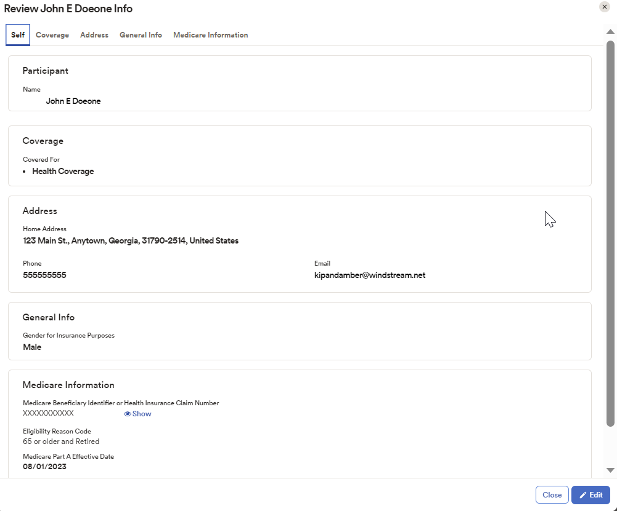
Manage Information
To update information, select Edit found at the bottom of the page to edit your information or provide additional information to SHBP, e.g., Medicare Part B information. If you don’t have any changes to your information, select Close in lower right of the page to navigate to the previous page.
Notes:
Review your information including your address , phone number, and Medicare information. If you’d like to update any of the information shown, hover over and click on the Edit button appearing at the bottom of the page. If the information displayed is accurate then select the Close option also appearing at the bottom of the page to return you to the previous page.
Now let’s take a moment to review the specifics for how to update your information….

Slide 41
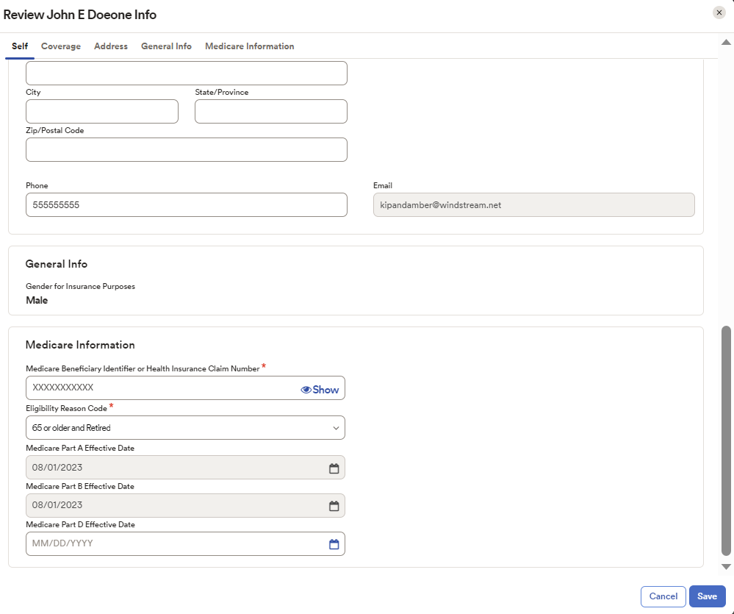
Manage Information
Scroll through the appropriate section of this page to modify the required information such as your address, phone number, or Medicare information.
It is important that you confirm that all information is accurate on this page.
If you need to update your Medicare information, you’ll need to have your Medicare card available to you.
Notes:
If you’d like to update any information on this page, then just hover over and modify the appropriate field or fields.
If the information displayed is accurate then select the Cancel button appearing in the lower, right corner of the page to return you to the previous page.
Now let’s review the various information available to be modified with particular attention paid to Medicare and Address information.

Slide 42
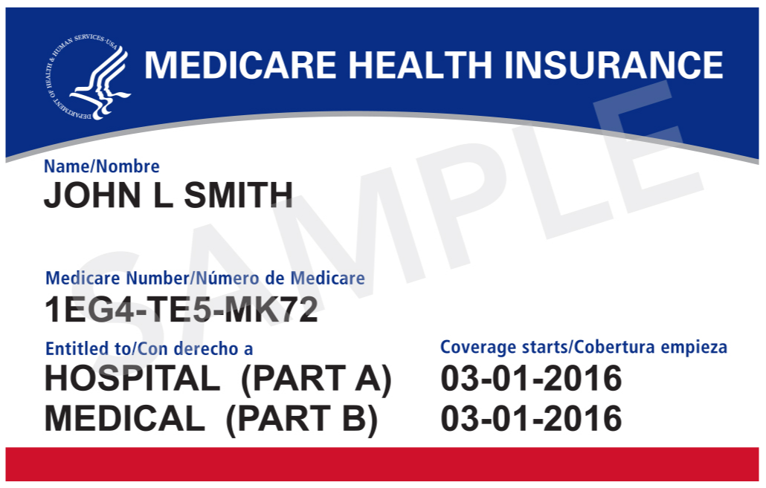
Manage Information
The following fields appear on the screen for you to modify :
Participant: Name
Coverage: This information is not editable. It reflects health coverage if you’re currently covered by SHBP.
Address: you may enter a Home address and Mailing Address. Please note P.O. Boxes are not allowed in the Home Address field but may be inserted in the Mailing Address Field as a secondary address.
General Info: This if your gender information and is not editable.
Medicare Information: Here you may enter your Medicare Beneficiary Identifier (MBI) exactly as it appears on your Red, White and Blue Medicare Card.
Remember to select Save at the bottom of the page to save your updated information.
Notes:
Shown here are the various types of information available on the Edit Manage Info screen.
Please note that when updating your Medicare information, be sure that the Medicare information in the Enrollment Portal matches the information found on your Red, White, and Blue Medicare card. In addition, be sure that your Medicare Beneficiary Identifier is exactly as it appears on your card as the Medicare Number.
Next, when it comes to your address, you can have both your home (or physical address) as well as your mailing address on file; however, you cannot have a P.O. Box appear as your home address. If you do have a P.O Box, be sure that it appears in the Mailing Address field.
Once you’ve made any required updates to your information remember to hover over and click on the Save button appearing at the bottom right of the page.

Slide 43
Need Help?
Notes:
If you need assistance then contact SHBP Member Services….

Slide 44

Need Help?
SHBP continues to offer the Co-Browse with a Representative feature for the upcoming Open Enrollment and Retiree Option Change Period. This will allow you to interact directly with an SHBP Member Services Representative when you log into the Portal.
This is how Co-Browse with a Representative works:
You will have the option to share your screen with SHBP Member Services Representative to help you navigate the SHBP Enrollment Portal through a view-only tool and answer your benefits questions.
Notes:
Should you need to contact Member Services regarding questions about the Enrollment Portal there will be the co-browse feature available to you and the representative. How it works is that you can share your screen within the Enrollment Portal with the representative using co-browse so that they are able to better assist you.
How do they do this?

Slide 45
Need Help?
Co-browse is built into the SHBP Enrollment Portal and allows you to give an SHBP Member Services Representative access to view your Enrollment Portal session with you.
The SHBP Member Services Representative will have access to highlight, point and scroll within the SHBP Enrollment Portal to assist you.
The SHBP Member Services Representative will not be able to see any other information on your laptop or desktop. ADP’s built-in security mechanism will grey out all portions of the screen other than the SHBP Enrollment Portal.
Notes:
Co-browse allows the Member Services representative to view your Enrollment Portal session with you to be able to address any questions. They can highlight as well as point and scroll within the Enrollment Portal to assist you; however, they cannot make any changes to your information while co-browsing with you.
Also, to ensure the privacy and protection of your information, the Member Services representative will only be able to see the information displayed within the Enrollment Portal while co-browsing with you – no other information on your laptop or desktop will be displayed for them.
Now let’s recap….

Slide 46
Need Help?
SHBP Enrollment Portal is Available 24 Hours a Day/7 Days a Week: mySHBPga.adp.com
  Members can elect coverage at home, on vacation, and anywhere convenient with a computer.
  The Co-Browse with a Representative feature will allow you to work with a representative when you log into the Portal
SHBP Member Services Email: SHBPservicecenter@adp.com
  You may email any questions you have to an SHBP Representative 24 hours a day, seven days a week.
  Email responses will be sent within 1-2 business days during normal business hours below.
SHBP Member Services Saturday Hours are Back October 21, 2023 through November 18, 2023!
  Monday – Friday 8:30 a.m. to 7:30 p.m. ET, Saturday 8:00 a.m. to 5:00 p.m. ET
  Too busy to wait? When the call center has high call volumes, you will be prompted to take advantage of Virtual Holds and Scheduled Callbacks.
Notes:
During this year’s Enrollment period, remember that you can access the SHBP Enrollment Portal 24 hours a day 7 days a week at mySHBPga.adp.com to make your benefit changes. You can select your coverage at home; on vacation or anywhere that is convenient for you.
Should you have questions while you’re navigating within the Enrollment Portal, you can co-browse with a Member Services representative. Member Services hours will be 8:30 AM to 5 PM Monday through Friday and Saturday from 8 AM to 5 PM. Saturday hours will begin October 21st and run through November 18th. In addition, during the Enrollment period from 10/16 – 11/3, there will be extended hours from 8:30 AM to 7:30 PM. Please note that when Member Services has high call volumes, you will be prompted to take advantage of virtual holds and scheduled callbacks. Since we recognize that your time is valuable, you may find it more convenient to send an email to SHBP Member Services at SHBPServiceCenter@adp.com – which is also available 24 hours a day 7 days a week. Should you need support with registration to the site or a password reset, you will need to call Member Services as these requests cannot be handled via email.

Slide 47
Thank You!
Notes:
Thank you for your time today.

