Slide 1
State Health Benefit Plan
2022 Train-the-Trainer
Open Enrollment Presentation for Plan Year 2023
Presentation to: SHBP Employing Entities
Presented by: SHBP Member Eligibility and Employer Services Unit
Date: October 13, 2022
Notes:
*Louis Amis’ recorded introduction will be played here*

Slide 2
Mission:
The mission of the Department of Community Health is to provide access to affordable, quality health care to Georgians through effective planning, purchasing, and oversight.
Notes:
Louis Amis will record the following:
The Mission of the Georgia Department of Community Health is to provide access to affordable, quality health care to Georgians through effective planning, purchasing and oversight.

Slide 3
Purpose
This Train-the-Trainer Presentation is an Open Enrollment reference tool for Employers. The purpose of this Presentation is to:
Provide Employers information on available reports produced during Open Enrollment so they can ensure eligible employees within their organization have an opportunity to enroll;
Provide Employers the revised schedules for billing reports for the remainder of 2022 through the January 2023 billing cycle, and
Assist Employing Entities with educating their eligible employees on the annual Open Enrollment period and plan options offered in Plan Year 2023.
Note: The Active Member Presentations and Decision Guide are reference tools for Open Enrollment for Active Members and Eligible Employees and are available on the SHBP website at https://shbp.georgia.gov/enrollment/open-enrollment. This year’s Open Enrollment (OE) will include in-person benefit fairs in addition to virtual meetings (either online or by phone) to educate on the Plan Options for the 2023 Plan Year. These meetings are designed for Commercial (active non-MA) SHBP members. The schedules for OE in-person benefit fairs and virtual meetings are available on the SHBP website at https://shbp.georgia.gov/enrollment/open-enrollment .
Notes:
This Train-the-Trainer Presentation is an Open Enrollment reference tool for Employers.
The purpose of this Presentation is to:
Provide Employers information on available reports produced during Open Enrollment so they can ensure eligible employees within their organization have an opportunity to enroll;
Provide Employers the revised schedules for billing reports for the remainder of 2022 through the January 2023 billing cycle, and
Assist Employing Entities with educating their eligible employees on the annual Open Enrollment period and plan options offered in Plan Year 2023.
Additionally, the Active Member Presentations and Decision Guide are reference tools for Open Enrollment for Active Members and Eligible Employees and are available on the SHBP website at SHBP dot Georgia dot Gov backslash enrollment backslash open dash enrollment.
This year’s Open Enrollment will include in-person benefit fairs in addition to virtual meetings, either online or by phone, to educate on the Plan Options for the 2023 Plan Year. These meetings are designed for Commercial, active non-MA, SHBP members. The schedules for OE in-person benefit fairs and virtual meetings are available on the SHBP website at SHBP dot Georgia dot Gov backslash enrollment backslash open dash enrollment.

Slide 4
Agenda
Skip the Phones
Electing SHBP Coverage
Employees & Retiring Employees Responsibilities
Dependent Verification
Open Enrollment Files
SHBP Plan Options
SHBP Rates
Questions
Notes:
Today’s presentation will include information on making a benefit election and the 2023 benefit offerings.
Specifically, we will discuss:
The benefits of using the New SHBP Enrollment Portal during Open Enrollment
Open Enrollment Dates and Responsibilities
2023 Plan Design and Options
Open Enrollment File Process, and
Dependent Verification and Rates
Let’s start the presentation!

Slide 5
I. Skip the Phones!
Notes:
The first section for review is Skip the Phones!

Slide 6
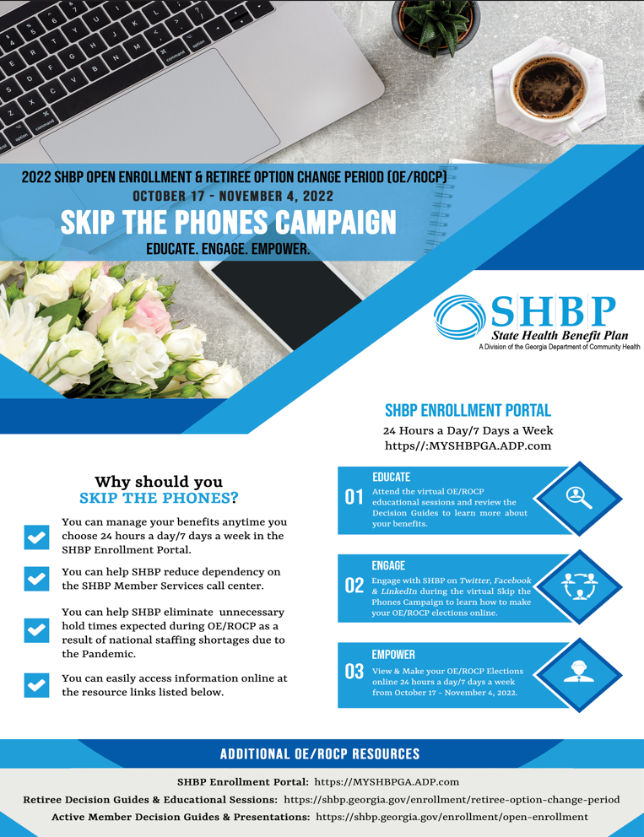
Skip the Phones!
The purpose of the Skip the Phones Campaign! is to steer our members to the new SHBP Enrollment Portal for this year’s Open Enrollment & Retiree Option Change Period (OE/ROCP) to:
Help members become comfortable with virtually taking control of their benefits
Reduce delays due to anticipated increased call volume
Staff shortages due to the COVID-19 pandemic are expected to impact call answer and hold times at our call center. SHBP is urging our members to access the SHBP Enrollment Portal for faster service.
Notes:
The purpose of the Skip the Phones Campaign! is to steer our members to the new SHBP Enrollment Portal for this year’s Open Enrollment & Retiree Option Change Period to:
Help members become comfortable with virtually taking control of their benefits
Reduce delays due to anticipated increased call volume
Staff shortages due to the COVID 19 pandemic are expected to impact call answer and hold times at our call center. SHBP is urging our members to access the SHBP Enrollment Portal for faster service.

Slide 7
Skip the Phones! (continued)
This year’s Open Enrollment is a “Passive Enrollment” period, which means the vendors and plan options offered by SHBP will remain the same as last year, so Active Members currently enrolled in coverage are not required to make an election unless they want to make changes.
For Active Members currently enrolled in coverage who take no action, their plan option will simply roll over to the same plan option in 2023. So, please inform your employees that if they’re happy with their current plan option and have no changes, they don’t have to take any action for this year’s Open Enrollment.
Notes:
This year’s Open Enrollment is a “Passive Enrollment” period, which means the vendors and plan options offered by SHBP will remain the same as last year, so Active Members currently enrolled in coverage are not required to make an election unless they want to make changes.
For Active Members currently enrolled in coverage who take no action, their plan option will simply roll over to the same plan option in 2023. So, please inform your employees that if they’re happy with their current plan option and have no changes, they don’t have to take any action for this year’s Open Enrollment.

Slide 8
Skip the Phones! (continued)
For your employees that are thinking about making changes, please share this link which includes the Skip the Phones! presentations with step-by-step instructions on making their election in the SHBP Enrollment Portal: https://shbp.georgia.gov/skip-phones.
Notes:
For your employees that are thinking about making changes, please share this link which includes the Skip the Phones! presentations with step-by-step instructions on making their election in the SHBP Enrollment Portal at SHBP DOT GEORGIA DOT GOV BACKSLASH SKIP DASH PHONES.

Slide 9
II. Electing SHBP Coverage
Notes:
NOW WE WILL TAKE A LOOK AT ELECTING SHBP COVERAGE.

Slide 10
Electing SHBP Coverage
In this section of the presentation, Electing SHBP Coverage, we will discuss the following:
SHBP Enrollment Portal – mySHBPga.adp.com
SHBP Mobile App
SHBP Member Services – 800.610.1863
SHBP Member Services – SHBPservicecenter@adp.com
Your Employees’ Responsibilities
Your Retiring Employees’ Responsibilities
What Happens If Your Employees Do Nothing?
Notes:
In the Electing SHBP Coverage section of the presentation, we will discuss:
How to elect SHBP Coverage using the SHBP Enrollment Portal or SHBP Member Services, which includes a New Co-browse with a Representative Feature
Our Mobile App
Overview of the SHBP Member Services Email System
Responsibilities of your Employees and Retiring Employees
And last but not least, What Happens if Your Employees Do Nothing?

Slide 11
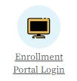
SHBP Enrollment Portal – mySHBPga.adp.com
The 2022 Open Enrollment period begins October 17, 2022 and ends November 4, 2022.
Your employees may make their health election at mySHBPga.adp.com.
Providing your employees’ the correct website is critical. Employees who make their elections through a non-SHBP ADP website or other third-party website will remain in the same elected Plan Options/Tiers in 2023 that they chose for Plan Year 2022. Note this situation has previously occurred.
Your employees’ may also visit the SHBP website and select the “Log in or Enroll” icon (or visit the Enrollment tab) that takes them directly to the SHBP Enrollment Portal: https://shbp.georgia.gov/.
Please remind your Employees that they can elect coverage online with their mobile devices (e.g., smartphones, iPads, etc.).
For Retired Teachers returning to Employment: Per HB 385, If a retired teacher returns to employment and wants to continue receiving their annuity, you as the employer should report the employee as benefits ineligible.
Notes:
10
Open Enrollment is October 17 through November 4, 2022.
Your employees may make online health coverage elections via the Enrollment Portal at My SHBP GA DOT ADP DOT COM
They may access the New Enrollment Portal via the SHBP Website and select the ‘Log in or Enroll’ Icon or visit the Enrollment Tab that takes them directly to the SHBP Enrollment Portal.
Providing your employees the correct Enrollment Portal is critical.
Employees who make elections through a non-SHBP ADP Website or other third party websites will remain in the same elected Plan Options/Tiers in 2023 that they chose for Plan Year 2022.
Mobile devices CAN be used to elect health coverage
For Retired Teachers returning to Employment under HB 385 and would like to continue receiving their annuity, the employer should report the employee as benefits ineligible.

Slide 12
SHBP Enrollment Portal – mySHBPga.adp.com (continued)
Online Election via Enrollment Portal
Enrollment Portal opens at 12:00 a.m. ET on October 17, 2022.
Enrollment Portal closes at 11:59 p.m. ET on November 4, 2022.
Last Confirmed Election is effective for 2023 Plan Year
Your employees may make their election online as many times as they choose within the dates/time periods above. However, the employees’ last confirmed election at the time the annual Open Enrollment period closes will be their election for the 2023 Plan Year.
Your employees should download or print and keep a copy of their confirmation page which will contain a confirmation number.
If employees do not receive a confirmation number documenting the new election, for SHBP purposes no election change was made by the employee.
Notes:
The SHBP Enrollment Portal opens for Online Open Enrollment Elections at 12:00 am Eastern Time on October 17, 2022 and closes at 11:59 pm Eastern Time on November 4, 2022.
Your employees may make as many elections as they choose during this time period; however, the employee’s last confirmed election at the time Open Enrollment closes will be their election for the 2023 Plan Year.
A confirmation number will be provided on the confirmation page. Your employees should download or print and keep a copy of the confirmation page.
If employees do not receive a confirmation number documenting the new election, for SHBP purposes no election change was made by the employee.

Slide 13
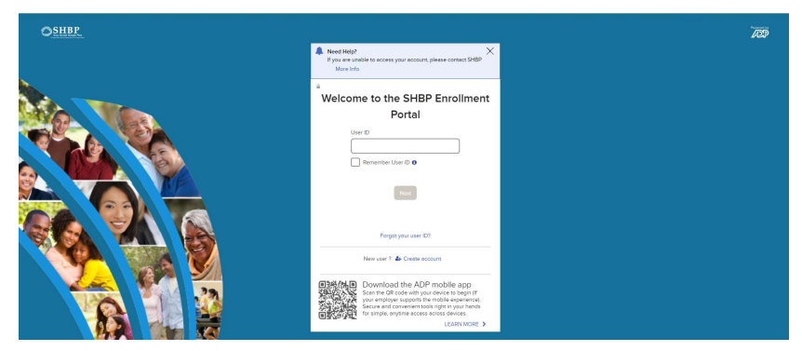
SHBP Enrollment Portal – mySHBPga.adp.com (continued)
Passwords are Frustration #1 for members!
My password doesn’t work.
It’s the last day of Open Enrollment and I can’t reach anyone at the call center to help me change my password.
It’s the last day of Open Enrollment and the call center is closed and I’m locked out of the Enrollment Portal.
Notes:
Passwords are the number one frustration for our members.
I’m sure you have heard:
My password doesn’t work.
It’s the last day of Open Enrollment and I can’t reach anyone at the call center to help me change my password.
It’s the last day of Open Enrollment and the call center is closed and I’m locked out of the Enrollment Portal.

Slide 14
SHBP Enrollment Portal – mySHBPga.adp.com (continued)
Reminder Messaging to Update Passwords went live in the SHBP Member Services IVR on September 19, 2022. Therefore, anyone who contacts SHBP Member Services prior to Open Enrollment will hear the below message:
Your 2022 Open Enrollment and Retiree Option Change Period for Plan Year 2023 is right around the corner. This year, the Open Enrollment and Retiree Option Change Period will be October 17th through November 4th. Did you know that you will remain enrolled in the same plan option and tier in 2023 that you're currently enrolled in unless you make a different election by November 4th? So, if you're happy with your current plan option and tier, no action is required. We strongly encourage you to visit the SHBP Enrollment Portal at MYSHBPGA.ADP.COM prior to October 17th to ensure your username and password allow you to access the Portal. If you have forgotten your username or password or if you have not logged into the portal within the last 12 months, please select the Forgot User ID or Forgot Your Password link at MYSHBPGA.ADP.COM. Thank you.
Notes:
Encourage your employees to Update their Passwords Now!
An IVR reminder message went live on September 19, 2022, reminding anyone who contacts SHBP Member Services of the upcoming Open Enrollment Period, Open Enrollment Dates, and to update Usernames and Passwords prior to October 17, 2022 to allow access to the Portal.
The message also advised if you forgotten your Username, Password, or have not logged in within the past 12 months, select the Forgot User ID or Forgot Password link on the Portal at My SHBP GA Dot ADP DOT Com.

Slide 15
SHBP Enrollment Portal – mySHBPga.adp.com (continued)
Employees passwords expire after 45 days
Therefore, if it has been over 45 days since an employee logged in, he/she will be prompted to create a New Password (which will also expire after 45 days).
What can Employers do to help?
Encourage your employees to login now (or anytime before Open Enrollment) to ensure their password is active through the last day of Open Enrollment, i.e., November 4, 2022.
Notes:
Your Employees’ passwords expire after 45 days. If it has been over 45 days since an employee logged in, he or she will be prompted to create a New Password.
Please encourage your employees to log in NOW to ensure their password is active through November 4, 2022, the last day of Open Enrollment.

Slide 16
SHBP Enrollment Portal – mySHBPga.adp.com (continued)
For Employees Who Have Not Logged into the SHBP Enrollment Portal within the 12 months:
Employees should log into the SHBP Enrollment Portal to set up their New Password at: https://myshbpga.adp.com;
Once the employee logs in using their current Password, they should be able to access their current benefits;
However, if it has been over 12 months since the last time the employee logged in, he/she will need to select the Forgot Your User ID? or Forgot Your Password? link from the Login Page and follow the prompts, as applicable.*
For Employees Who Do Not Know Their User ID and/or Password to Log into the SHBP Enrollment Portal:
Employees should visit the SHBP Enrollment Portal at: https://myshbpga.adp.com;
Then employees should select the Forgot Your User ID? or Forgot Your Password? Link from the Login Page and follow the prompts, as applicable.*
* Forgot Your User ID? will display if the User has not yet entered their User ID on the SHBP Enrollment Portal login page.
Notes:
Here’s how it works:
For Employees Who Have Not Logged into the SHBP Enrollment Portal within the 12 months:
Employees should log into the SHBP Enrollment Portal to set up their New Password at MY SHBP GA DOT ADP DOT COM
Once the employee logs in using their current Password, they should be able to access their current benefits
However, if it has been over 12 months since the last time the employee logged in, they will need to select the Forgot Your User ID? or Forgot Your Password? link from the Login Page and follow the prompts
For Employees Who Do Not Know Their User ID and/or Password to Log into the SHBP Enrollment Portal:
Employees should visit the SHBP Enrollment Portal at MY SHBP GA DOT ADP DOT COM
Then employees should select the Forgot Your User ID? or Forgot Your Password? Link from the Login Page and follow the prompts

Slide 17
SHBP Enrollment Portal – mySHBPga.adp.com (continued)
For Employees Who Have Never Used the SHBP Enrollment Portal (i.e., Registering for the First Time):
Employees should review the step-by-step instructions in the Skip the Phones! presentation at https://shbp.georgia.gov/skip-phones.*
Employees may also view enrollment instructions on the SHBP website: https://shbp.georgia.gov/enrollment-portal.
SHBP’s registration code is: SHBP-GA
*Detailed registration information is also included in the Active Member Decision Guide, “Making Your Health Benefit Election for 2023” section at: https://shbp.georgia.gov/enrollment/open-enrollment
Notes:
Employees who have never used the Enrollment Portal and Registering for the first time should:
Review the step-by-step instructions in the Skip the Phones presentation at SHBP DOT GEORGIA DOT GOV BACKSLASH SHIP DASH PHONES as indicated in this presentation
Employees may also view enrollment instructions on the SHBP Website also as indicated in this presentation

Slide 18
SHBP Enrollment Portal – mySHBPga.adp.com (continued)
The Co-Browse with a Representative feature will allow your employees to interact directly with an SHBP Member Services Representative when they log into the Portal.
This is how Co-Browse with a Representative works:
Employees will have the option to share their screen with SHBP Member Services Representative to help them navigate the SHBP Enrollment Portal through a view-only tool and answer their benefits questions.
Notes:
The Co-Browse with a Representative feature will allow your employees to interact directly with an SHBP Member Services Representative when they log into the Portal.
This is how Co-Browse with a Representative works:
Employees will have the option to share their screen with SHBP Member Services Representative to help them navigate the SHBP Enrollment Portal through a view-only tool and answer their benefits questions.

Slide 19
SHBP Enrollment Portal – mySHBPga.adp.com (continued)
Co-browse is built into the SHBP Enrollment Portal and allows your employees to give an SHBP Member Services Representative access to view their Enrollment Portal session with them.
The SHBP Member Services Representative will have access to highlight, point and scroll within the SHBP Enrollment Portal to assist your employees.
The SHBP Member Services Representative will not be able to see any other information on your employees’ laptop or desktop. ADP’s built-in security mechanism will grey out all portions of the screen other than the SHBP Enrollment Portal.
Notes:
Co-browse is built into the SHBP Enrollment Portal and allows your employees to give an SHBP Member Services Representative access to view their Enrollment Portal session with them.
The SHBP Member Services Representative will have access to highlight, point and scroll within the SHBP Enrollment Portal to assist your employees.
The SHBP Member Services Representative will not be able to see any other information on your employees’ laptop or desktop. ADP’s built-in security mechanism will grey out all portions of the screen other than the SHBP Enrollment Portal.

Slide 20
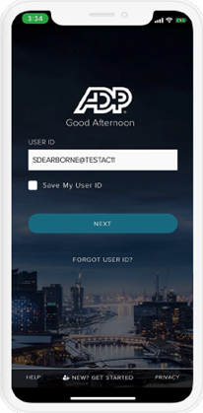
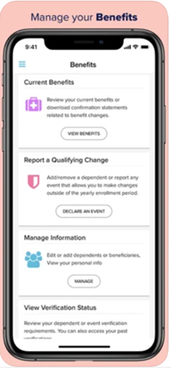
SHBP Enrollment Portal – ADP Mobile App
iPhones on App Store: https://apps.apple.com/us/app/adp-mobile-solutions/id444553167
Android on Google Play: https://play.google.com/store/apps/details?id=com.adpmobile.android
Notes:
The SHBP Enrollment Portal ADP Mobile App was successfully implemented during our prior Open Enrollment period for iPhone and Android users.
The Mobile App for iPhone users is located on the App Store.
The Mobile App for Android users is located on Google Play.

Slide 21
SHBP Member Services – 800.610.1863
SHBP Member Services has Extended Hours for Open Enrollment, but we need you to encourage your employees to Skip the Phones!
Monday thru Friday, 8:30 a.m. to 7:30 p.m. ET during Open Enrollment and Saturday, 8:00 a.m. to 5:00 p.m. ET (normally 8:30 a.m. to 5:00 p.m. ET, Monday - Friday).
For your employees that are thinking about making changes, please share this link which includes Skip the Phones! presentations with step-by-step instructions on making their election in the SHBP Enrollment Portal: https://shbp.georgia.gov/skip-phones.
Active Members currently enrolled in coverage who take no action will simply roll over to the same plan option they are currently enrolled in. So, please inform your employees that if they’re happy with their current plan option and have no changes, they don’t have to take any action for this year’s Open Enrollment.
Notes:
SHBP Member Services has extended the hours during Open Enrollment, but we would like for you to encourage your employees to Skip the Phones!
The extended SHBP Member Services hours during Open Enrollment are 8:30 am to 7:30 pm, Monday through Friday and Saturday hours are 8:00 am to 5:00 pm.
If your employees are considering making changes, share the Skip the Phones presentation link with them for step-by-step instructions on making their elections.
Remember, Active Members who are currently enrolled and take no action will roll over to the same plan option they are currently enrolled in.
If your employees are happy with their current plan option and have no changes; they do not have to take any actions this Open Enrollment.

Slide 22
SHBP Member Services – SHBPservicecenter@adp.com
The SHBP Member Services Email System is available year-round to members (and eligible employees) who have registered in the SHBP Enrollment Portal.
Hours of Operation: emails accepted 24 hours a day 7 days a week. Responses are provided within 1 to 2 business days.
Important
Employees CANNOT Email Their Elections: elections, life events, demographic updates (e.g., name, address, SSN) cannot be made via email.
Employees Can Ask Questions about Open Enrollment: Open Enrollment questions can be asked via email, but elections cannot be requested via email.
Response Emails: will only be provided to the email address on file for the member, or the email address specified by the member for communications. If a member has provided another email address for communications, other than the email address in the SHBP Enrollment Portal, no response will be sent to the email address in the SHBP Enrollment Portal.
Notes:
The SHBP Member Services Email System is still available year round to members and eligible employees who have registered in the SHBP Enrollment Portal.
Emails are accepted 24 hours a day, 7 days a week and responses are provided within 1 to 2 business days.
Here are some Important notes:
Employees CANNOT Email Their Elections. Elections, life events, demographic updates cannot be made via email.
Employees Can Ask Questions about Open Enrollment. Open Enrollment questions can be asked via email, but elections cannot be requested via email.
Response Emails will only be provided to the email address on file for the member, or the email address specified by the member for communications. If a member has provided another email address for communications, other than the email address in the SHBP Enrollment Portal, no response will be sent to the email address in the SHBP Enrollment Portal.

Slide 23
III. Employees & Retiring Employees Responsibilities
Notes:
Let’s review the responsibilities of Employees and Retiring Employees.

Slide 24
Your Employees’ Responsibilities
Employees should read and make sure they understand the information in the Active Member Decision Guide and Plan Documents posted on the SHBP website https://shbp.georgia.gov/plan-documents.
Employees should review the 2023 Rates and Plan Options posted on the SHBP website https://shbp.georgia.gov/active-rates.
Employees should confirm that they answered the Tobacco Surcharge question appropriately. If no election changes are made and the Employee previously answered yes, the Tobacco Surcharge will carry over to the 2023 Plan Year.
Employees should check their payroll deduction to verify that the correct deduction amount has been made each month.
Employees should update any changes in their contact information by notifying their HR Department.
Notes:
YOUR EMPLOYEE’S DO HAVE RESPONSIBILITIES DURING OPEN ENROLLMENT.
Employees should read and make sure they understand the information in the Active Member Decision Guide and Plan Documents posted on the SHBP website at SHBP DOT GEORGIA DOT GOV BACKSLASH PLAN DASH DOCUMENTS.
Employees should review the 2023 Rates and Plan Options posted on the SHBP website at SHBP DOT GEORGIA DOT GOV BACKSLASH ACTIVE DASH RATES.
Employees should confirm that they answered the Tobacco Surcharge question appropriately. If no election changes are made and the Employee previously answered yes, the Tobacco Surcharge will carry over to the 2023 Plan Year.
Employees should check their payroll deduction to verify that the correct deduction amount has been made each month.
Employees should update any changes in their contact information by notifying their HR Department.

Slide 25
Your Employees’ Responsibilities (continued)
Employees should know if they: 1) make an election effective in Plan Year 2022 as a New Hire (New Hire event) or 2) declare a Qualifying Event resulting in a new election effective in Plan Year 2022 during the Open Enrollment window, the New Hire or Qualifying Event election will override the Open Enrollment election for Plan Year 2023, unless:
On the confirmation page after making the New Hire or Qualifying Event election, the employee follows the automated prompt in the SHBP Enrollment Portal and makes a subsequent change to their Open Enrollment election for Plan Year 2023 (even if they previously made their Open Enrollment election prior to the New Hire or Qualifying event).
Note: if an employee’s hire date occurs after November 1, 2022, they will only receive an Open Enrollment Window. A New Hire Window will not appear.
Notes:
Employees should know if they make an election effective in Plan Year 2022 as a New Hire or declare a Qualifying Event resulting in a new election effective in Plan Year 2022 during the Open Enrollment window, the New Hire or Qualifying Event election will override the Open Enrollment election for Plan Year 2023 unless:
On the confirmation page after making the New Hire or Qualifying Event election, the employee follows the automated prompt in the SHBP Enrollment Portal and makes a subsequent change to Open Enrollment election for Plan Year 2023, even if they previously made their Open Enrollment election prior to the New Hire or Qualifying Event.
Additionally, if an employee’s hire date occurs after November 1, 2022, they will only receive an Open Enrollment Window. A New Hire Window will not appear.

Slide 26
Your Employees’ Responsibilities (continued)
Employees should upload their Dependent Verification documentation directly into the SHBP Enrollment Portal for newly added Dependents no later than December 5, 2022 to ensure they receive ID Cards prior to January 1, 2023.
Courtesy Dependent Verification Notification Letters and/or emails will also be sent to your employees who add new dependents. If they do not receive a letter or email, they should contact their HR Department to ensure SHBP has the correct address and/or email address on file if they do not receive a letter or email.
Your employees have 45 days to provide Dependent Verification Documentation to SHBP after enrolling their Dependent in SHBP coverage.
Failure to provide valid Dependent Verification documentation for newly added Dependents by December 5, 2022 will result in delays in receipt of ID cards to sometime in January 2023, so please encourage your employees to upload their Dependent Verification documentation directly into the SHBP Enrollment Portal by December 2, 2022.
Notes:
Dependent Verifications documents should be uploaded by the employee directly into the SHBP Enrollment Portal for newly added dependents no later than December 5, 2022 to ensure the receipt of ID Cards prior to January 1, 2023
Courtesy Dependent Verification Notification Letters and/or emails will also be sent to your employees who add new dependents. If they do not receive a letter or email, they should contact their HR Department to ensure SHBP has the correct address and/or email address on file if they do not receive a letter or email.
Your employees have 45 days to provide Dependent Verification Documentation to SHBP after enrolling their Dependent in SHBP coverage.
Failure to provide valid Dependent Verification documentation for newly added Dependents by December 5, 2022 will result in delays in receipt of ID cards to sometime in January 2023, so please encourage your employees to upload their Dependent Verification documentation directly into the SHBP Enrollment Portal by December 2, 2022.

Slide 27
Your Retiring Employees’ Responsibilities
Employees retiring on January 1, 2023 who are not currently enrolled in the SHBP cannot carry coverage as a SHBP retiree (i.e., Employees must enroll during Open Enrollment the year prior to their retirement).
Employees who make a change during Open Enrollment but retire before the change can become effective on January 1, will remain in their current elections, plan option/tier prior to Open Enrollment or waiver of coverage status, with covered or no covered dependents, as applicable.
Employees planning to retire must update their email address in the SHBP Enrollment Portal from their former work email address to a personal or other email address so they can receive SHBP email notifications. Otherwise, email notifications will continue to be sent to their former work email address.
Employees planning to retire must update their physical address and phone number so they can receive hard copy SHBP notifications. Otherwise, notifications will continue to be sent to an inaccurate address and we will be unable to contact via phone.
Notes:
Employees retiring on January 1, 2023 who are not currently enrolled in the SHBP cannot carry coverage as a SHBP retiree. For example, Employees must enroll during Open Enrollment the year prior to their retirement.
Employees who make a change during Open Enrollment but retire before the change can become effective on January 1, 2023 will remain in their current elections, plan option/tier prior to Open Enrollment or waiver of coverage status, with covered or no covered dependents, as applicable.
Employees planning to retire must update their email address in the SHBP Enrollment Portal from their former work email address to a personal or other email address so they can receive SHBP email notifications. Otherwise, email notifications will continue to be sent to their former work email address.
Employees planning to retire must update their physical address and phone number so they can receive hard copy SHBP notifications. Otherwise, notifications will continue to be sent to an inaccurate address and we will be unable to contact via phone.

Slide 28
Your Retiring Employees’ Responsibilities (continued)
Employees planning to retire should:
Review the SHBP Planning to Retire Presentation on our website at https://shbp.georgia.gov/planning-retire
Review SHBP Retiree Decision Guide on our website at https://shbp.georgia.gov/retiree-option-change-period.
Determine the Subsidy policy they are subject to, i.e., the Annuitant Basic Subsidy Policy or Annuitant Years of Service Subsidy Policy at https://shbp.georgia.gov/retiree-rates.
Resources for Retiring Employees:
Retiree Rates (including Subsidy information): https://shbp.georgia.gov/retiree-rates.
Turning Age 65: https://shbp.georgia.gov/retirees-0/turning-age-65.
Medicare: https://shbp.georgia.gov/retirees-0/retirees-medicare.
Notes:
There are 3 steps employees planning to retire should complete:
Review the SHBP Planning to Retire Presentation on our website at SHBP DOT GEORGIA DOT GOV BACKSLASH PLANNING DASH RETIRE
Review SHBP Retiree Decision Guide on our website at SHBP DOT GEORGIA DOT GOV BACKSLASH RETIREE DASH OPTION DASH CHANGE DASH PERIOD
Determine the Subsidy policy they are subject to, meaning the Annuitant Basic Subsidy Policy or Annuitant Years of Service Subsidy Policy at SHBP DOT GEORGIA DOT GOV BACKSLASH RETIREE DASH RATES
Resources for Retiring Employees can be accessed on the SHBP Website including Retiree Rates, Turning Age 65 and Medicare information at the website addresses indicated on this slide.

Slide 29
IV. Dependent Verification
Notes:
It’s time to take a look at Dependent Verification.

Slide 30
Dependent Verification
In this section of the presentation, Dependent Verification, we will discuss the following:
Dependent Verification Process
Pended Events
Non-Pended Events
Pending Dependent Report
Notes:
In this section of the presentation we will review:
The dependent Verification Process
Pending and Non-Pending Events
Along with the Pending Dependent Report

Slide 31
Dependent Verification Process
Pending Status: Dependents are Not Added to coverage until the Member provides verification of their Dependent’s eligibility. Dependents awaiting approval are placed in a PENDING status.
Premium Billing: SHBP Does Not bill Employers for Dependents until the verification documentation has been received and approved. Therefore, Employers should not bill Active Members for a Plan Option and/or Tier change until it is adjusted on their Premium Billing Report (BRP). Dependents will appear on the next Premium Billing Report (BRP) after their effective date.
Approvals: If Dependent’s verification documentation is approved, they will be added to Member’s coverage in the SHBP Enrollment Portal and Third-Party Administrators* system as of the effective date, in accordance with SHBP Rules and Regulations.
Failures: If Dependent fails the verification process, the Employer’s bill is not impacted.
*Note: Files are transmitted to Third Party Administrators twice a week.
Notes:
THE overall Dependent Verification Process includes the following:
Pending Status: Dependents are Not Added to coverage until the Member provides verification of their Dependent’s eligibility. Dependents awaiting approval are placed in a PENDING status.
Premium Billing: SHBP Does Not bill Employers for Dependents until the verification documentation has been received and approved. Therefore, Employers should not bill Active Members for a Plan Option and/or Tier change until it is adjusted on their Premium Billing Report . Dependents will appear on the next Premium Billing Report after their effective date.
Approvals: If Dependent’s verification documentation is approved, they will be added to Member’s coverage in the SHBP Enrollment Portal and Third-Party Administrators system as of the effective date, in accordance with SHBP Rules and Regulations.
Failures: If Dependent fails the verification process, the Employer’s bill is not impacted.

Slide 32
Dependent Verification Process (continued)
Pended Events
Below is a list of all Events that Pend in the SHBP Enrollment Portal until the Active Member or eligible employee provides documentation that meets SHBP’s list of approved verification documents or until the deadline to provide the documentation has passed, whichever occurs first. This means the Plan Option and/or Tier will not change in the SHBP Enrollment Portal or in the Third Party Administrators medical system.
Marriage
Divorce
Gain Guardianship
Lose Guardianship
Gain Coverage Elsewhere Due to Dependent’s Employment or Employer’s Open Enrollment
Lose Group Coverage Elsewhere
Dependent(s) Gain Medicaid
Dependent(s) Loses PeachCare or Medicaid
Change My Tobacco User Status
Open Enrollment / Retiree Option Change Period
Notes:
This is a list of all Events that Pend in the Enrollment Portal until SHBP approved verification documents are received or until the deadline to provide the documents has passed, whichever come first.
Marriage
Divorce
Gain Guardianship
Lose Guardianship
Gain Coverage Elsewhere Due to Dependent’s Employment or Employer’s Open Enrollment
Lose Group Coverage Elsewhere
Dependent Gain Medicaid
Dependent Loses PeachCare or Medicaid
Change My Tobacco Status
Open Enrollment Retiree Option Change Period
The Plan Option or Tier will not change in the Portal or TPAs until the event is no longer pending.
Marriage
Divorce
Gain Guardianship
Lose Guardianship
Gain Coverage Elsewhere Due to Dependent’s Employment or Employer’s Open Enrollment
Lose Group Coverage Elsewhere
Dependent(s) Gain Medicaid
Dependent(s) Loses PeachCare or Medicaid
Change My Tobacco User Status
Open Enrollment / Retiree Option Change Period

Slide 33
Dependent Verification Process (continued)
Non-Pended Events
Below is a list of all Events that Do Not Pend in the SHBP Enrollment Portal, meaning coverage is added immediately prior to the Active Member or eligible employee providing verification documentation. This means the Plan Option and/or Tier will change in the SHBP Enrollment Portal and the change will be transmitted via file to SHBP TPAs.
Birth
Adoption
Death of Dependent
If the Member fails to subsequently provide the required verification documentation, a retroactive change to the Plan Option and/or Tier, if applicable, will appear on the:
Employer’s Proof Bill next business day, and
Employer’s Premium Billing Report (BRP) in 1 to 2 billing cycles.
Notes:
THE EVENTS OF BIRTH, ADOPTION AND DEATH OF A DEPENDENT DO NOT PEND IN THE PORTAL AND COVERAGE IS IMMEDIATELY PRIOR TO THE ACTIVE MEMBER OR ELIGIBLE EMPLOYEE PROVIDES VERIFICATION DOCUMENTATION.
The Plan Option and Tier will change in the portal and the change will be transmitted by file to the TPAs.
If the Member does not subsequently provide the required verification documentation, a retroactive change to the Plan Option and/or Tier, if applicable, will appear on the:
Employer’s Proof Bill next business day, and
Employer’s Premium Billing Report in 1 to 2 billing cycles.

Slide 34
Pending Dependent Report
The Pending Dependent Report’s name is a misnomer but is very helpful in determining the status of your Employees recently declared Qualifying Events.
Report Includes: 1) SHBP Members and eligible employees requesting to enroll or disenroll from Coverage, and 2) SHBP Members with pending dependent(s) to be added or removed from Coverage due to a Qualifying Event.
Naming Convention: Reports will be named SHBP_(Payroll Location Number)_(YYYY)_Pending_Dependents_(MMDDYYYY)_(Seq#).csv
Data Cutoff: This report is produced weekly and posted to Employers’ Payroll Location(s) in the State Health Repository Tool (SHRT) each Monday. The report contains data up to the end of the day on Sunday.
Notes:
The Pending Dependent Report may be accessed on SHRT and is very helpful in determining the status of your employee’s recently declared Qualifying Events.
The Report Includes:
1) SHBP Members and eligible employees requesting to enroll or disenroll from Coverage
2) SHBP Members with pending dependents to be added or removed from Coverage due to a Qualifying Event.
The Report will have the Naming Convention of SHBP UNDERSCORE PAYROLL LOCATION NUMBER UNDERSCORE YEAR UNDERSCORE PENDING UNDERSCORE DEPENDENTS UNDERSCORE DATE UYNDERSCORE SEQUENCE NUMBER DOT CSV.
This report is produced weekly and posted to Employers’ Payroll Location(s) in the State Health Repository Tool each Monday. The report contains data up to the end of the day on Sunday.

Slide 35
Pending Dependent Report (continued)
Employee Data will fall off the report when one of the following occurs prior to the cutoff:
The employee has successfully provided the correct verification documentation for their dependent(s); has been approved by the DVS unit; and coverage has been updated in the SHBP Enrollment Portal.
The employee has failed to provide the correct verification documentation for their dependent(s) within the time period allowed.
The employee’s dependent(s) failed the audit.
Employee Data will remain on subsequent reports if one of the following applies prior to cutoff:
The employee has successfully provided the correct verification documentation for their dependent(s); has been approved by the DVS unit, but their coverage has not yet been updated in the SHBP Enrollment Portal. This can take 2-3 business days after an Audit is complete.
The employee has taken no action on the DVS Audit and it is still open.
Notes:
Employee Data will fall off the report when one of the following occurs prior to the cutoff:
The employee has successfully provided the correct verification documentation for their dependents; has been approved by the DVS unit; and coverage has been updated in the SHBP Enrollment Portal.
The employee has failed to provide the correct verification documentation for their dependents within the time period allowed.
The employee’s dependents failed the audit.
Employee Data will remain on subsequent reports if one of the following applies prior to cutoff:
The employee has successfully provided the correct verification documentation for their dependents; has been approved by the DVS unit, but their coverage has not yet been updated in the SHBP Enrollment Portal. This can take 2 to 3 business days after an Audit is complete.
The employee has taken no action on the DVS Audit and it is still open.

Slide 36
Pending Dependent Report (continued)
Reconciliation: Employers should review the report each week and reach out to their affected employees to encourage them to take action on the open DVS Audit.
If you do not have a report in your SHRT folder it means that you do not have any employees with outstanding pending dependents.
SHBP will not bill Employers for Pending Dependents until they are added to coverage.
Pending Dependents are not discrepancies so please do not submit them on your Discrepancy Report as no action will be taken.
Notes:
For Reconciliation the Employers should review the report each week and reach out to the affected employees to encourage them to take action on the open DVS Audit.
If you do not have a report in your SHRT folder it means that you do not have any employees with outstanding pending dependents.
SHBP will not bill Employers for Pending Dependents until they are added to coverage.
Pending Dependents are not discrepancies so please do not submit them on your Discrepancy Report as no action will be taken.

Slide 37
Pending Dependent Report (continued)
Sample Pending Dependent Report*
*This report is produced weekly and posted to Employers’ Payroll Location(s) in SHRT each Monday. The report contains data up to the end of the day on Sunday.
Notes:
This slide provides a Pending Dependent Report Sample from SHRT. Please note there is no Protected Heath Information displayed on the report sample.

Slide 38
V. Open Enrollment Files
Notes:
Let’s take a quick look at Open Enrollment Files

Slide 39
Open Enrollment Files
In this section of the presentation, Open Enrollment Files, we will discuss the following:
Open Enrollment No Action Report (OE NO ACTION)
Proof Bills
Deduction Files
Premium Billing
Notes:
Under Open Enrollment Files we will discuss:
The Open Enrollment No Action Report
Proof Bills and Deduction Files
Along with Premium Billing

Slide 40
Open Enrollment File Process
October 18, 2022: ADP will produce a report each day beginning October 18, 2022 titled ‘OE NO ACTION’. This report will identify your location’s employees who have not made an open enrollment election. Please use this report to follow-up with your employees to remind them make their election by the last day of Open Enrollment, November 4, 2022.
Through November 10, 2022: ADP will produce Daily Proof Bills (if applicable) & Deduction files that will reflect 2022 new hire and benefit status changes
No 2022 Proof Bills produced after 11/10
No 2022 Deduction Files produced after 11/10
November 12, 2022: Employers will receive a FULL 2023 Deduction file that will reflect all deductions for your Employees for 2023 (even when $0)
Boards of Education and Non-SAO Employers: Full Deduction file(s) will be posted to SHRT.
State Agencies and Other Employing Entities Participating in SAO: Full Deduction file will be transmitted to SAO for processing.
Notes:
Let’s look at important dates and information surrounding the Open Enrollment File Process:
October 18, 2022: ADP will produce a report each day beginning October 18, 2022 titled ‘OE NO ACTION’. This report will identify your location’s employees who have not made an open enrollment election. Please use this report to follow-up with your employees to remind them make their election by the last day of Open Enrollment, November 4, 2022.
Through November 10, 2022: ADP will produce Daily Proof Bills, if applicable and Deduction files that will reflect 2022 new hire and benefit status changes
No 2022 Proof Bills produced after November 10, 2022
No 2022 Deduction Files produced after November 10, 2022
November 12, 2022: Employers will receive a FULL 2023 Deduction file that will reflect all deductions for your Employees for 2023, even when ZERO dollars
Boards of Education and Non-SAO Employers: Full Deduction files will be posted to SHRT.
State Agencies and Other Employing Entities Participating in SAO: Full Deduction file will be transmitted to SAO for processing.

Slide 41
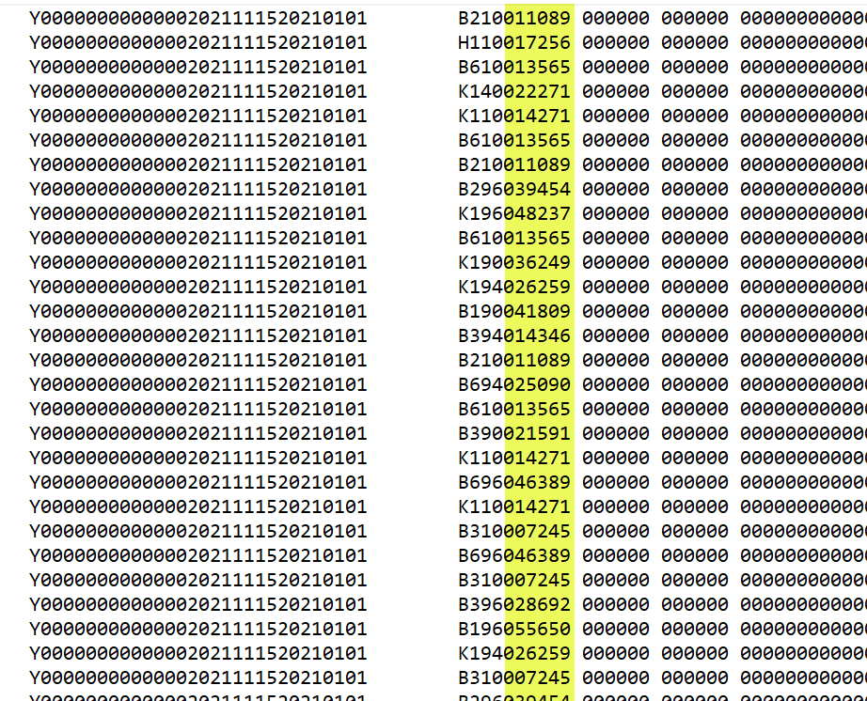
Open Enrollment File Process (continued)
Sample Full Deduction File: Boards of Education and Employers Not Participating in SAO
Deduction files have 655 characters on each Employee Data Line. The employee deduction amount can be found in Positions 412 - 417 of the file.
If you are unable to locate the deduction amount, please contact your IT department or IT vendor for assistance.
Note: Full Deduction file will be transmitted to SAO for processing for State Agencies and Other Employing Entities Participating in SAO.
Notes:
This screen displays the Full Deduction File Sample for Boards of Education and Non-SAO Employers.
Deduction files have 655 characters on each Employee Data Line. The employee deduction amount can be found in Positions 412 - 417 of the file.
If you are unable to locate the deduction amount, please contact your IT department or IT vendor for assistance.
Additionally, Full Deduction files will be transmitted to SAO for processing for State Agencies and Other Employing Entities Participating in SAO.

Slide 42
Open Enrollment File Process (continued)
December 1, 2022 - February 28, 2023: Employers will receive
PRIOR YEAR Proof Bill Report: ALL 2022 Plan Year transactions processed after November 10, 2022.
DAILY Proof Bill Report: ALL 2023 Plan Year transactions processed after November 10, 2022. This will only contain daily transactions and will be posted each day, unless no transaction processed the prior day.
Deduction Files: containing 2023 Plan Year Deduction File updates.
No Later than January 9, 2023: the January premium billing report will be posted to SHRT. Note this date is later than the typical posting date that occurs on the 28th of the prior month. Please do not transfer funds or pay via check until the January 2023 Premium Billing Reports and Vouchers have been posted.
Notes:
December 1, 2022 through February 28, 2023, Employers will receive:
PRIOR YEAR Proof Bill Report. ALL 2022 Plan Year transactions processed after November 10, 2022.
DAILY Proof Bill Report. ALL 2023 Plan Year transactions processed after November 10, 2022. This will only contain daily transactions and will be posted each day, unless no transaction processed the prior day.
Deduction Files containing 2023 Plan Year Deduction File updates.
The January premium billing report will be posted to SHRT no later than January 9, 2023. This date is later than the typical posting date that occurs on the 28th of the prior month. Please do not transfer funds or pay via check until the January 2023 Premium Billing Reports and Vouchers have been posted.

Slide 43
VI. SHBP Plan Options
Notes:
Now it time to look at SHBP Plan Options

Slide 44
SHBP Plan Options
In this section of the presentation, SHBP Plan Options, we will discuss the following:
2023 Plan Options
Member Identification Cards
Notes:
In the SHBP Plan Options section we will discuss:
2023 Plan Options and Member Identification Cards

Slide 45
2023 SHBP Plan Options
Plan Options | Anthem Blue Cross & Blue Shield | UnitedHealthcare | Kaiser Permanente
Statewide Health Maintenance Organization (HMO) | ✓ | ✓
Health Reimbursement Arrangement (HRA) | ✓
High Deductible Health Plan (HDHP) |  | ✓
Regional Health Maintenance Organization (HMO) |  |  | ✓
Plan Options and Designs will remain the same: No changes to copays, co-insurance, deductibles.
For more information on Plan Designs: please review the Active Member Decision Guide & Presentation on the SHBP website at https://shbp.georgia.gov/enrollment/open-enrollment.
Notes:
For Plan Year 2023 there are no changes in copays, co-insurance or deductibles.
The Plan Options and Designs will remain the same.
Anthem Blue Cross & Blue Shield Plan Options are Statewide Health Maintenance Organization and Health Reimbursement Arrangement
United Health Care Plan Options are Statewide Health Maintenance Organization and High Deductible Health Plan
AND Kaiser Plan Option is Regional Health Maintenance Organization

Slide 46
Member Identification (ID) Cards
Anthem and UnitedHealthcare
All SHBP Members enrolled in Anthem and UnitedHealthcare plan options will receive new Member ID cards before January 1st.
Newly added Dependents pending Dependent Verification review and approval after December 5, 2022 will not receive new Member ID cards until after January 1, 2023.
Kaiser Permanente (KP)
New Kaiser Permanente Members will receive new Member ID cards before January 1st
Newly added Dependents pending Dependent Verification review and approval after December 5, 2022 will not receive new Member ID cards until after January 1, 2023.
Due to mailing restrictions, Members may receive cards at different times.
Notes:
All members enrolling in Anthem and United Healthcare will receive new ID cards before January 1, 2023. Their newly added dependents still pending DVS review for approval after December 5, 2022, will not receive new ID Cards until after January 1, 2023.
For Kaiser, only NEW Kaiser members will receive new ID cards before January 1, 2023.
Their newly added dependents still pending DVS review and approval after December 5, 2022 , will not receive new ID Cards until after January 1, 2023.

Slide 47
VII. SHBP Rates
Notes:
It’s time to look at SHBP Rates.

Slide 48
SHBP Rates
In this section of the presentation, SHBP Rates, we will discuss the following:
2023 Active Member Rates
2023 Employer Contribution Rates
Notes:
2023 Active Member Rates and Employer Contribution Rates will be reviewed in this section of the presentation

Slide 49
2023 SHBP Active Member Rates
The SHBP Active Member Rates for Plan Year 2023 are currently available on the SHBP Website at https://shbp.georgia.gov/active-rates.
Rates for the following groups for Plan Year 2023 are also available on the SHBP website at https://shbp.georgia.gov/member-rates.
Retirees
Boards of Education Board Members
Contract Employer Groups, COBRA & State Extended Coverage (SEC)
The Resolutions approved by the Board of Community Health are posted at https://shbp.georgia.gov/resolutions.
Notes:
2023 Active Member Rates for Plan Year 2023 are located on the SHBP website at SHBP DOT GEORGIA DOT GOV BACKSLASH ACTINE DASH RATES.
The Plan Year 2023 Rates for the following groups are located on the SHBP website at SHBP DOT GEORGIA DOT GOV BACKSLASH MEMBER DASH RATES:
Retirees
Boards of Education Board Members
AND Contract Employer Groups, COBRA and State Extended Coverage
The Resolutions approved by the Board of Community Health are posted on the SHBP website at SHBP DOT GEORGIA BACKSLASH RESOLUTIONS.

Slide 50
2023 SHBP Employer Contribution Rates
The Employer Contributions will remain the same and are available on the SHBP website at https://shbp.georgia.gov/resolutions:
Teachers: $945.00 per month for each enrolled employee
Librarians: $843.00 per month for each enrolled employee
Public School Employees: $945.00 per month for each enrolled employee
State Agencies: 29.454% of total salaries
Notes:
Employer Contributions have remained the same and are available on the SHBP Website at SHBP DOT GEORGIA DOT GOV BACKSLASH RESOLUTIONS.
Employer Contributions are as follows:
Teachers: $945.00 per month for each enrolled employee
Librarians: $843.00 per month for each enrolled employee
Public School Employees: $945.00 per month for each enrolled employee
State Agencies: 29.454% of total salaries

Slide 51
VIII. Employer Questions
Notes:
Last but not least, lets take a look at receiving assistance with your employer questions….

Slide 52
Employer Questions
For assistance, please contact your dedicated Employer Services Specialists via the:
(X)change at https://shbp.georgia.gov/employers-0/your-employing-entity/xchange, or
Phone at 800.610.1863, Monday through Friday, 8:30 am to 5:00 pm ET. Due to the COVID-19 pandemic, our Specialist are working from home. However, if you leave a message, a Specialist will follow up with you via the (X)change and/or their mobile work phone.
For escalated matters, please reference the SHBP Employer (X)change Escalation Process posted on the Employer Services section of the SHBP website: https://shbp.georgia.gov/xchange-escalation-process
Notes:
Employers may contact their dedicated employer services specialist via the Xchange for assistance at SHBP DOT GEORGIA DOT GOV BACKSLASH DASH O BACKSLASH YOUR DASH EMPLOYING DASH ENTITY BACKSLASH XCHANGE
Or you may also phone 800.610.1863, Monday thru Friday, 8:30 am to 5 pm.
Please note, due to COVID 19 our specialists are working from home. However, if you leave a message , a specialists will follow up with you via Xchange and/or their mobile work phones.
Please reference the SHBP Employer Xchange Escalation Process posted on the employer services section of the SHBP Website for Escalated matters at SHBP DOT GEORGIA DOT GOV BACKSLASH XCHANGE DASH ESCALATION DASH PROCESS.

Slide 53
Purpose:
Shaping the future of A Healthy Georgia by improving access and ensuring quality to strengthen the communities we serve.
Notes:
This brings us to the end of the presentation. We will now provide responses to questions received from our employers during Registration and open the Chat for possible additional questions.

